Slide 1
Towards Untrusted Social Video Verification to Combat Deepfakes
via Face Geometry Consistency
Eleanor Tursman, Marilyn George, Seny Kamara, James Tompkin
Notes:
Hello, I’m Eleanor Tursman, and I’m here to speak about deepfake detection using social video verification.
We face a future where faked videos of humans, dubbed “deepfakes,” could suffuse our media, court systems, and news.

Slide 2
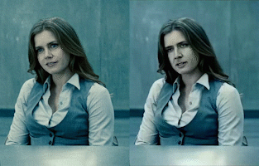
By Source (WP:NFCC#4), Fair use, https://en.wikipedia.org/w/index.php?curid=61555724
Notes:
Many of us have seen videos online or in the news where machine learning is used to dramatically, but realistically, alter people for comedic effect. Unfortunately, not all altered content is benign, and subtle expression manipulation of a speaker can have dramatic social impact. Developing robust deepfake detection is therefore of the utmost importance.

Slide 3
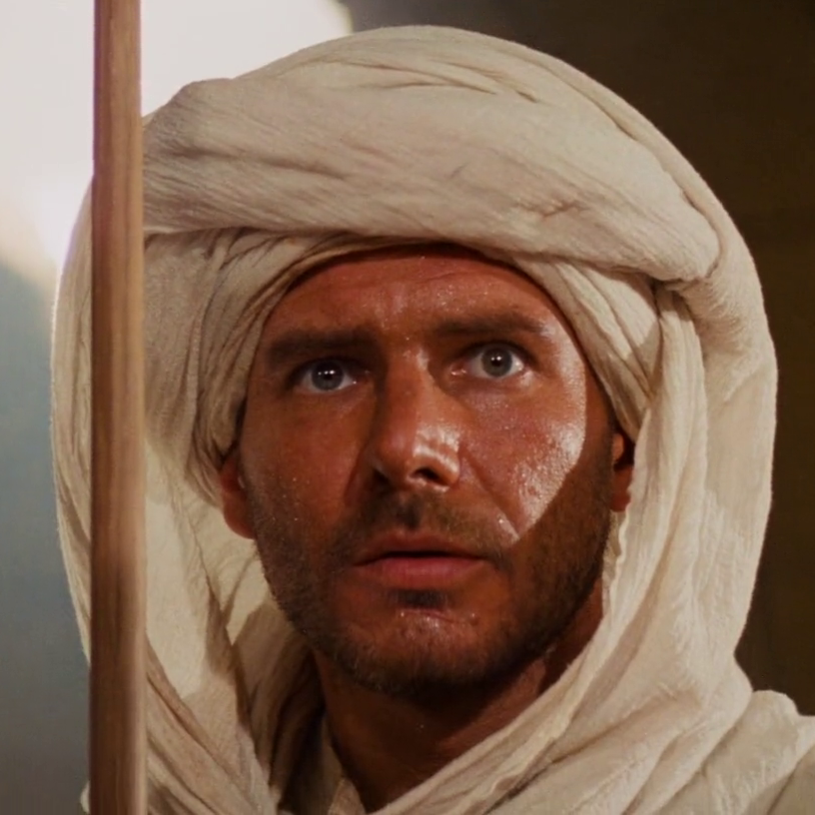
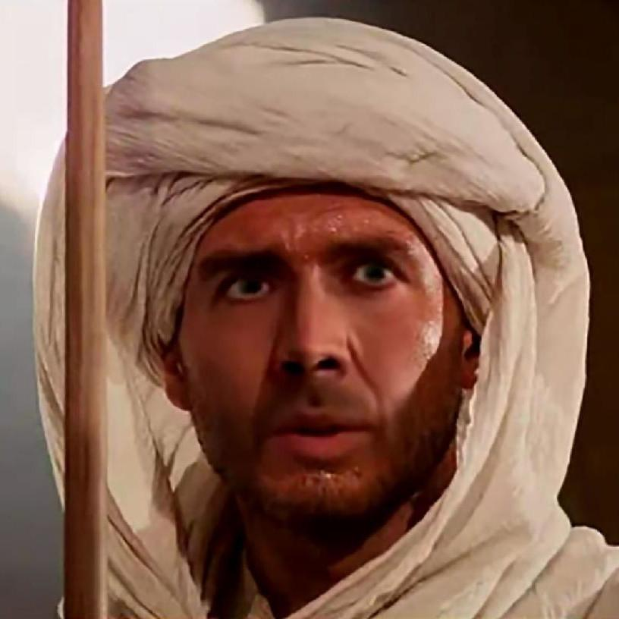
Left: Still from Spielberg, Raiders of the Lost Ark. Right: Still from "Nic Cage is the new Indiana JONES (confirmed) (deepfakes)" YouTube, uploaded by Nick Cage DeepFakes, https://www.youtube.com/watch?v=v0zFR0ElRd4.
Notes:
Many deepfake detection methods classify individual videos by identifying certain visual tells, such as temporal flicker or smoothing. These have a great deal of value, but we hypothesize that in the near future, deepfakes will no longer have these tells.

Slide 4
Faked Video
Real Video
Notes:
Suppose we find two videos online of the same speech, where one video is a visually perfect deepfake. Using existing detection methods, we can no longer establish which, if either, of these two videos is unmodified.

Slide 5
Faked Video
Real Video
?
Notes:
Suppose we find two videos online of the same speech, where one video is a visually perfect deepfake. Using existing detection methods, we can no longer establish which, if either, of these two videos is unmodified.

Slide 6
Faked Video
Real Video
?
?
Notes:
Suppose we find two videos online of the same speech, where one video is a visually perfect deepfake. Using existing detection methods, we can no longer establish which, if either, of these two videos is unmodified.

Slide 7
Faked Video
Real Video
?
?
?
Notes:
Suppose we find two videos online of the same speech, where one video is a visually perfect deepfake. Using existing detection methods, we can no longer establish which, if either, of these two videos is unmodified.

Slide 8
Faked Video
Real Video
?
?
?
?
Notes:
Suppose we find two videos online of the same speech, where one video is a visually perfect deepfake. Using existing detection methods, we can no longer establish which, if either, of these two videos is unmodified.

Slide 9
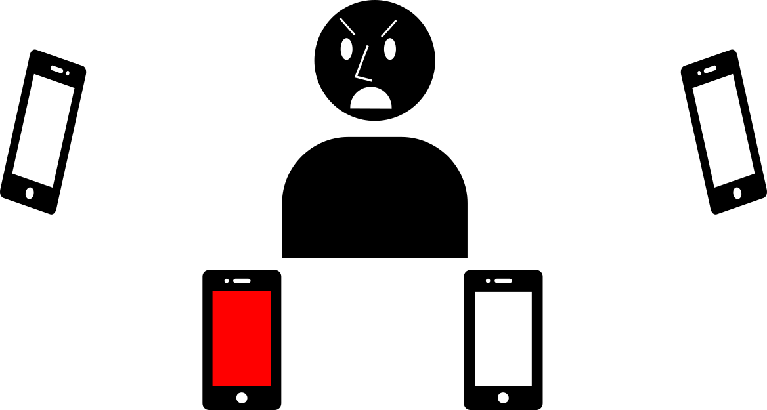
Social Video Verification
Notes:
To address this scenario, we propose detection via social verification at capture time. With a social verification setup, a group of video cameras synchronously capture a speaker, collectively reach consensus on the speaker’s appearance, then sign their videos in real time as being true.

Slide 10
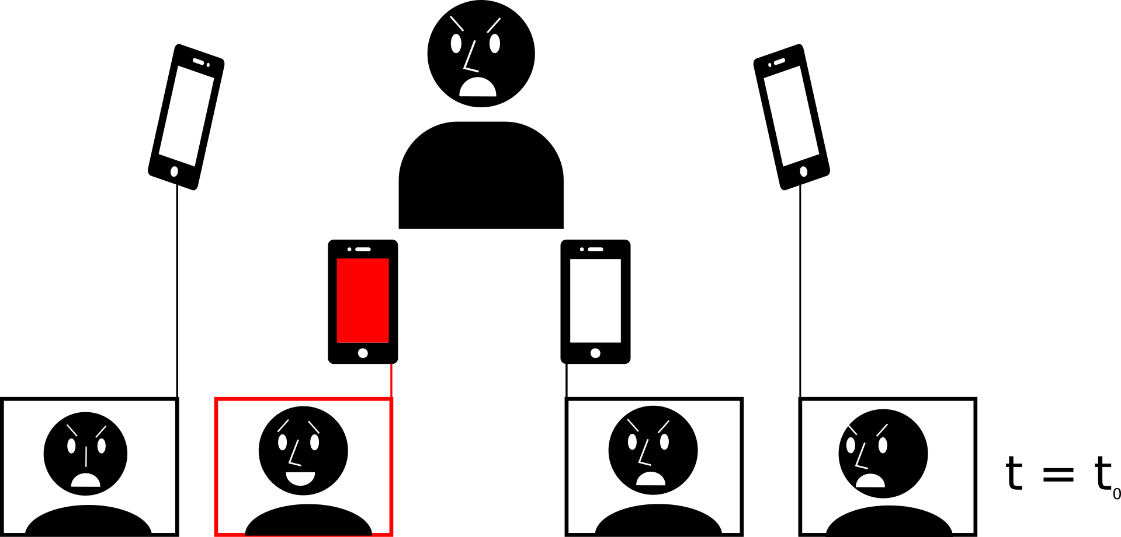
Social Video Verification
Notes:
To address this scenario, we propose detection via social verification at capture time. With a social verification setup, a group of video cameras synchronously capture a speaker, collectively reach consensus on the speaker’s appearance, then sign their videos in real time as being true.

Slide 11
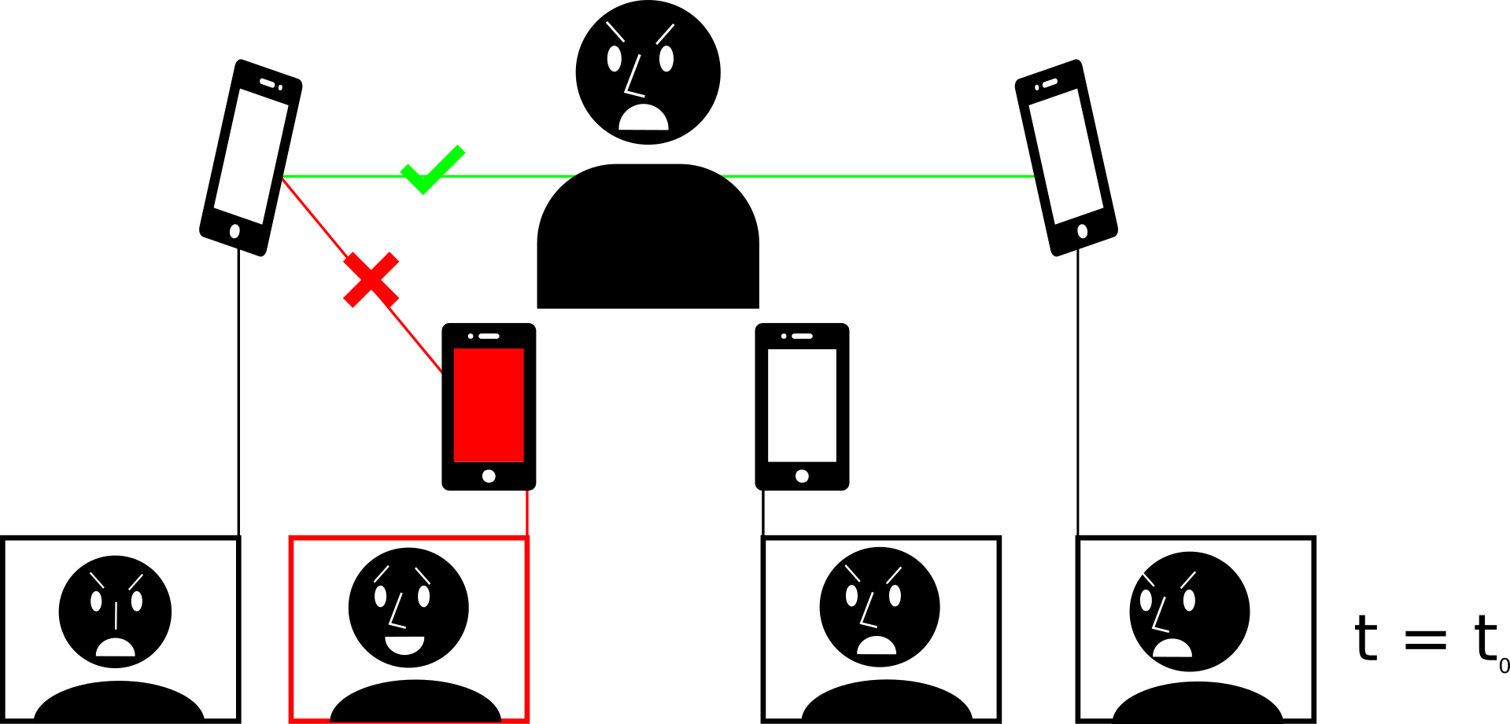
Social Video Verification
Notes:
To address this scenario, we propose detection via social verification at capture time. With a social verification setup, a group of video cameras synchronously capture a speaker, collectively reach consensus on the speaker’s appearance, then sign their videos in real time as being true.

Slide 12
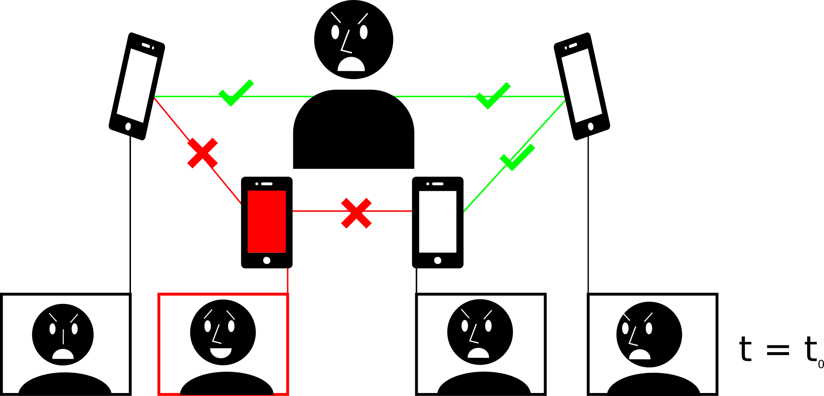
Social Video Verification
Notes:
To address this scenario, we propose detection via social verification at capture time. With a social verification setup, a group of video cameras synchronously capture a speaker, collectively reach consensus on the speaker’s appearance, then sign their videos in real time as being true.

Slide 13
Social Video Verification
Notes:
To address this scenario, we propose detection via social verification at capture time. With a social verification setup, a group of video cameras synchronously capture a speaker, collectively reach consensus on the speaker’s appearance, then sign their videos in real time as being true.

Slide 14
Benefits of Social Video Verification
Fakes are more difficult to make.
Notes:
The benefits to this setup are three-fold. First, it makes the creation of fakes more difficult. Attackers must make modifications in real time which must fool the consensus-driven representation. Second, authentic crowd-signed videos can be used as a basis of truth for verifying other videos uploaded after the event. Third, there does not need to be any pre-existing trust within the group.

Slide 15
Benefits of Social Video Verification
Fakes are more difficult to make.
Verify new videos against a crowd-signed video.
Notes:
The benefits to this setup are three-fold. First, it makes the creation of fakes more difficult. Attackers must make modifications in real time which must fool the consensus-driven representation. Second, authentic crowd-signed videos can be used as a basis of truth for verifying other videos uploaded after the event. Third, there does not need to be any pre-existing trust within the group.

Slide 16
Benefits of Social Video Verification
Fakes are more difficult to make.
Verify new videos against a crowd-signed video.
No need for pre-existing trust.
Notes:
The benefits to this setup are three-fold. First, it makes the creation of fakes more difficult. Attackers must make modifications in real time which must fool the consensus-driven representation. Second, authentic crowd-signed videos can be used as a basis of truth for verifying other videos uploaded after the event. Third, there does not need to be any pre-existing trust within the group.

Slide 17
Consensus Computation Requirements
Consensus metric must be:
Pose invariant
Resistant to fakes
Fast
Data-efficient
Notes:
To implement social video verification, cameras must agree on the depiction of a speaker across angled views, while rejecting cameras offering manipulated content to the group. The computation for consensus must be fast, and involve as little data as possible to achieve real time results. Within the scope of this work, we propose and evaluate a consensus computation based on the hierarchical clustering of variance in 2D mouth landmark motion over time and across cameras.

Slide 18
Notes:
Suppose we have a set of synchronized videos of a speaker, where some or none of the videos are faked.

Slide 19
Notes:
We fit landmarks per video per frame,

Slide 20
Notes:
then isolate landmarks by face part, such as the eyes or mouth.

Slide 21
Notes:
We perform classical principal component analysis, or PCA, on each normalized subset of landmarks to capture the variation in face motion per video.

Slide 22
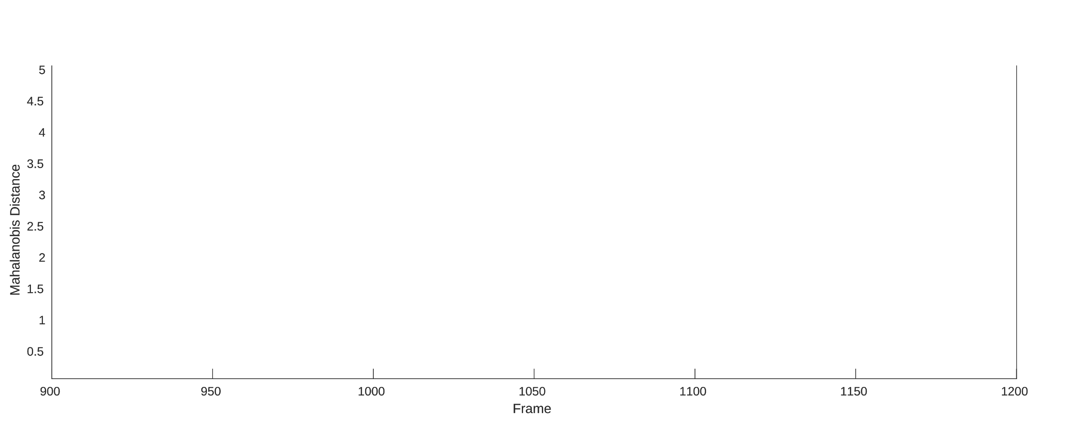
Notes:
We label each frame with the Mahalanobis distance between the center of the PCA subspace and the frame’s landmarks’ projection into the PCA subspace. Videos with similar landmark variance through time will have similar Mahalanobis distances per frame, regardless of viewing angle, thus isolating our fake videos.

Slide 23
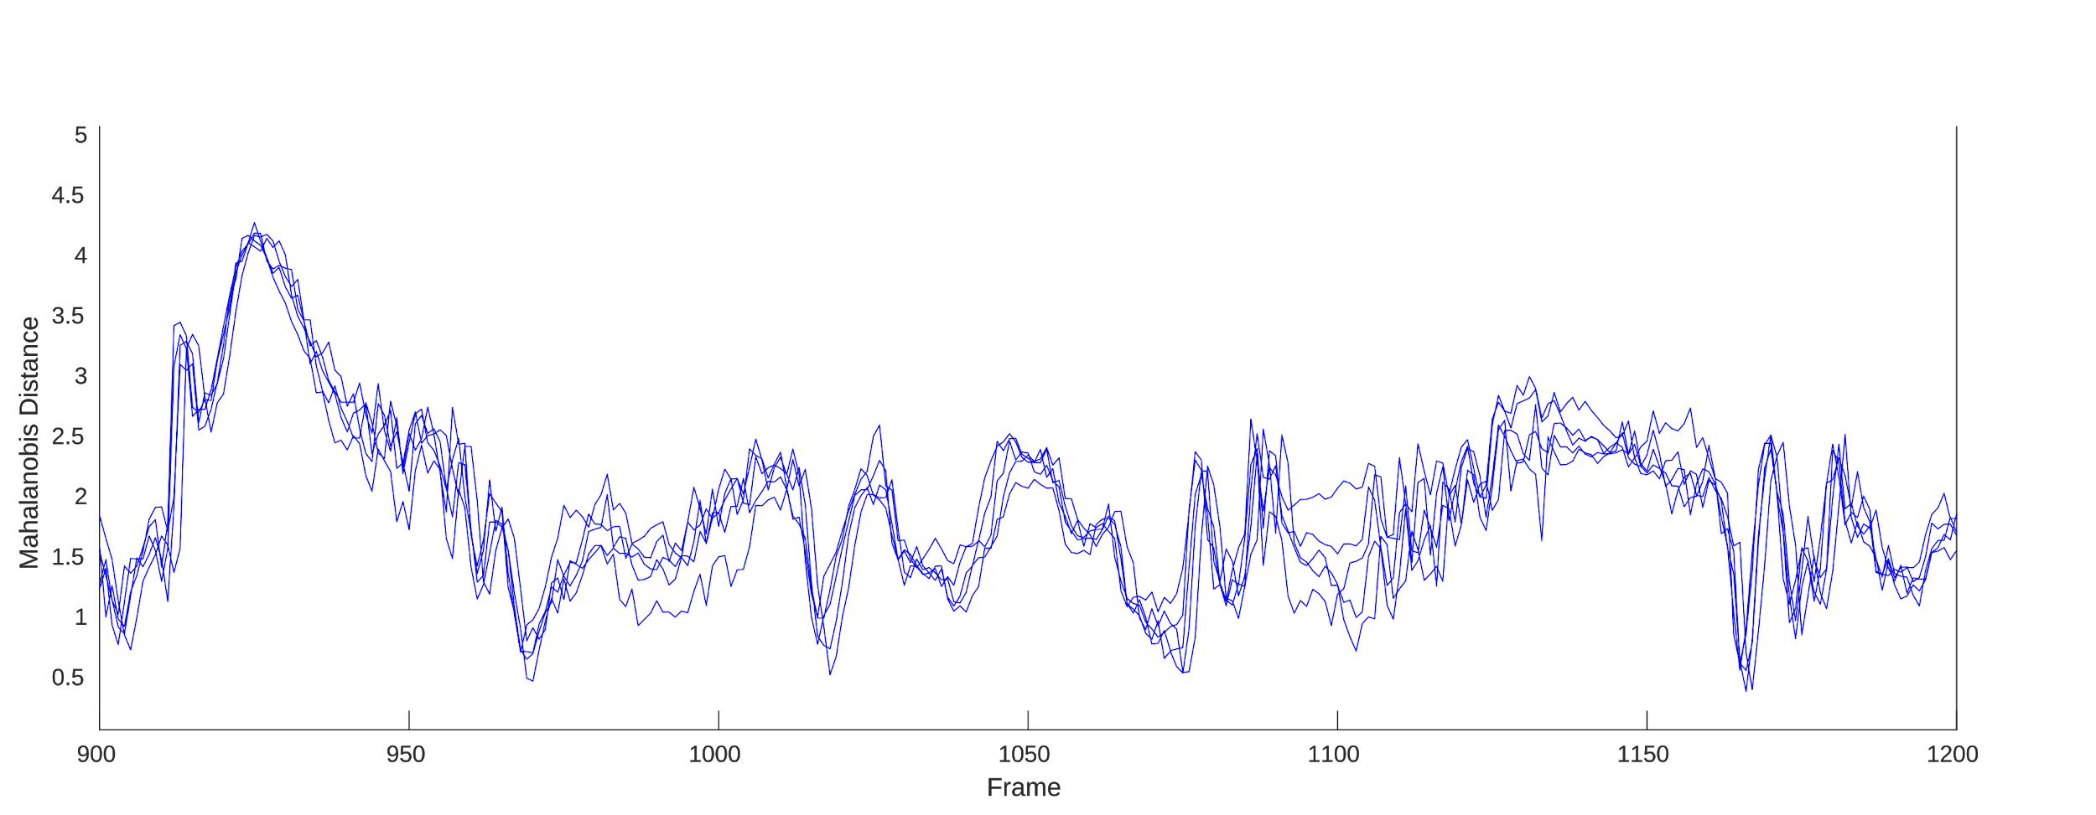
Notes:
We label each frame with the Mahalanobis distance between the center of the PCA subspace and the frame’s landmarks’ projection into the PCA subspace. Videos with similar landmark variance through time will have similar Mahalanobis distances per frame, regardless of viewing angle, thus isolating our fake videos.

Slide 24
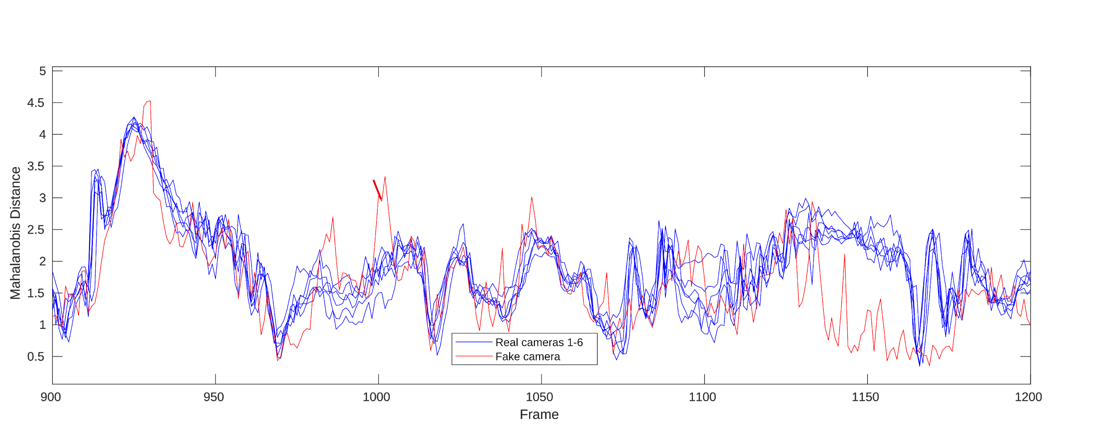
Notes:
We label each frame with the Mahalanobis distance between the center of the PCA subspace and the frame’s landmarks’ projection into the PCA subspace. Videos with similar landmark variance through time will have similar Mahalanobis distances per frame, regardless of viewing angle, thus isolating our fake videos.

Slide 25
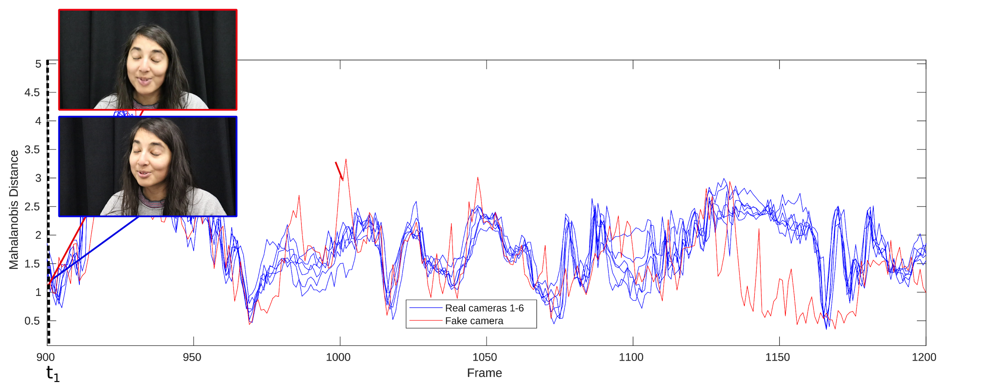
Notes:
We label each frame with the Mahalanobis distance between the center of the PCA subspace and the frame’s landmarks’ projection into the PCA subspace. Videos with similar landmark variance through time will have similar Mahalanobis distances per frame, regardless of viewing angle, thus isolating our fake videos.

Slide 26
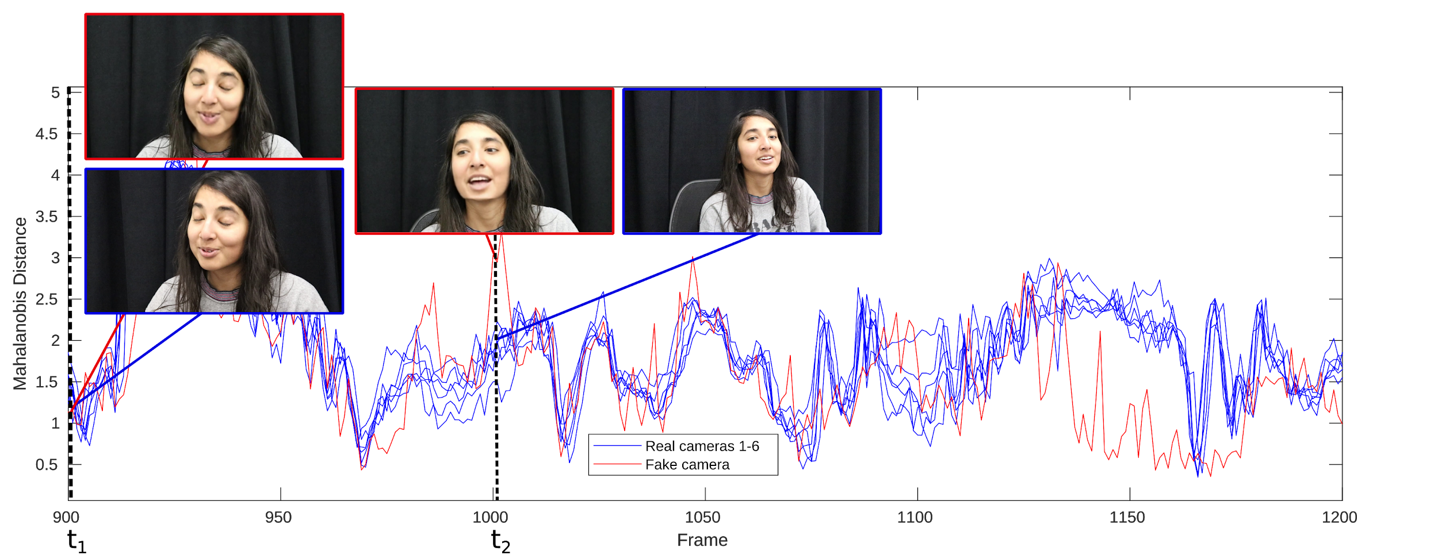
Notes:
We label each frame with the Mahalanobis distance between the center of the PCA subspace and the frame’s landmarks’ projection into the PCA subspace. Videos with similar landmark variance through time will have similar Mahalanobis distances per frame, regardless of viewing angle, thus isolating our fake videos.

Slide 27
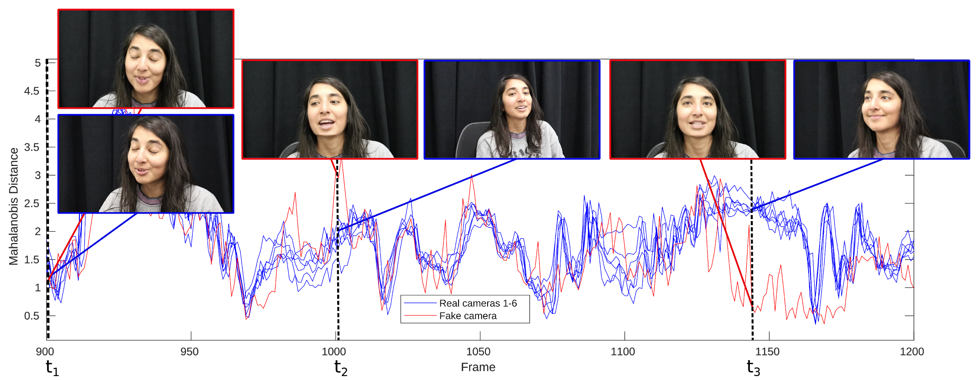
Notes:
We label each frame with the Mahalanobis distance between the center of the PCA subspace and the frame’s landmarks’ projection into the PCA subspace. Videos with similar landmark variance through time will have similar Mahalanobis distances per frame, regardless of viewing angle, thus isolating our fake videos.

Slide 28
Notes:
We hierarchically cluster these 2D signals to produce a weighted binary tree. When the ratio between two consecutive additions to the tree is above a set experimental threshold, we cut the tree-- the rest of the leaves are not similar enough to meet our consensus requirements. The cameras corresponding to our clustered leaves are our final verified cameras for the given time window.

Slide 29
Notes:
We hierarchically cluster these 2D signals to produce a weighted binary tree. When the ratio between two consecutive additions to the tree is above a set experimental threshold, we cut the tree-- the rest of the leaves are not similar enough to meet our consensus requirements. The cameras corresponding to our clustered leaves are our final verified cameras for the given time window.

Slide 30
Notes:
We hierarchically cluster these 2D signals to produce a weighted binary tree. When the ratio between two consecutive additions to the tree is above a set experimental threshold, we cut the tree-- the rest of the leaves are not similar enough to meet our consensus requirements. The cameras corresponding to our clustered leaves are our final verified cameras for the given time window.

Slide 31
Notes:
We hierarchically cluster these 2D signals to produce a weighted binary tree. When the ratio between two consecutive additions to the tree is above a set experimental threshold, we cut the tree-- the rest of the leaves are not similar enough to meet our consensus requirements. The cameras corresponding to our clustered leaves are our final verified cameras for the given time window.

Slide 32
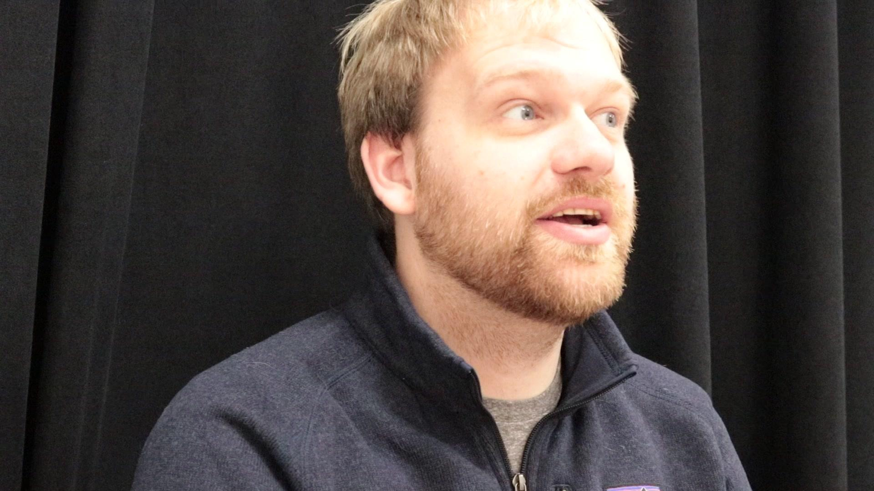
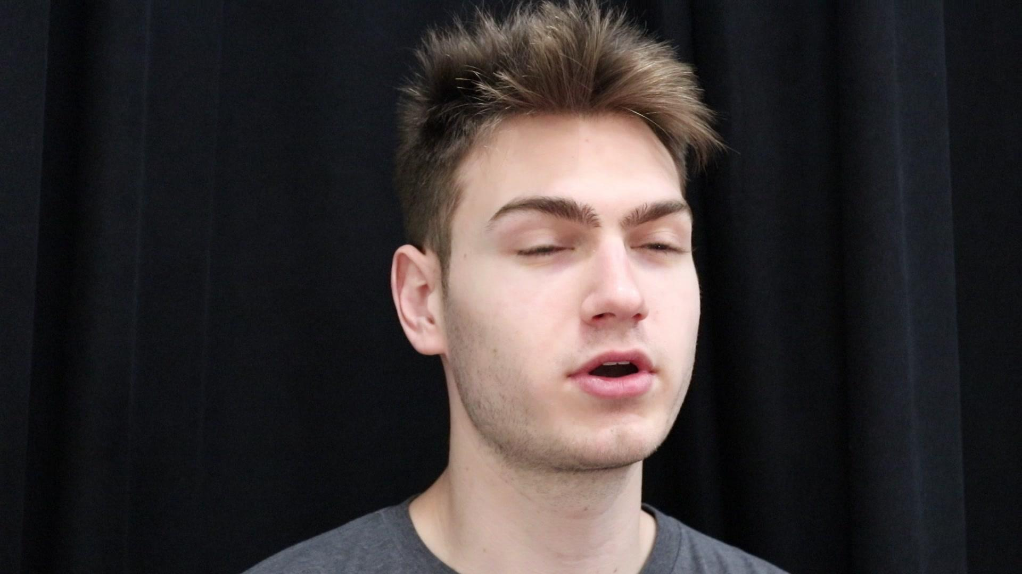
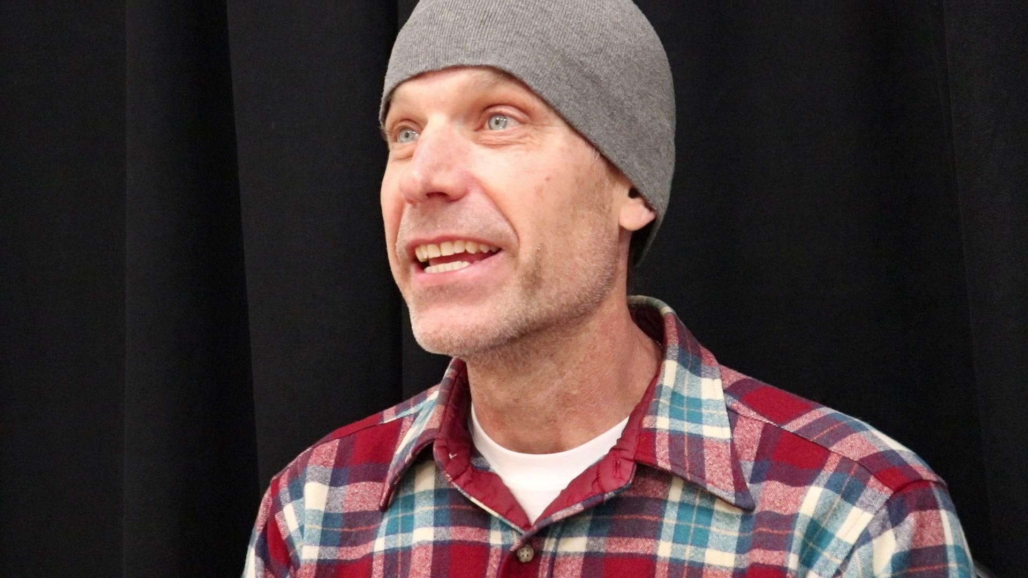
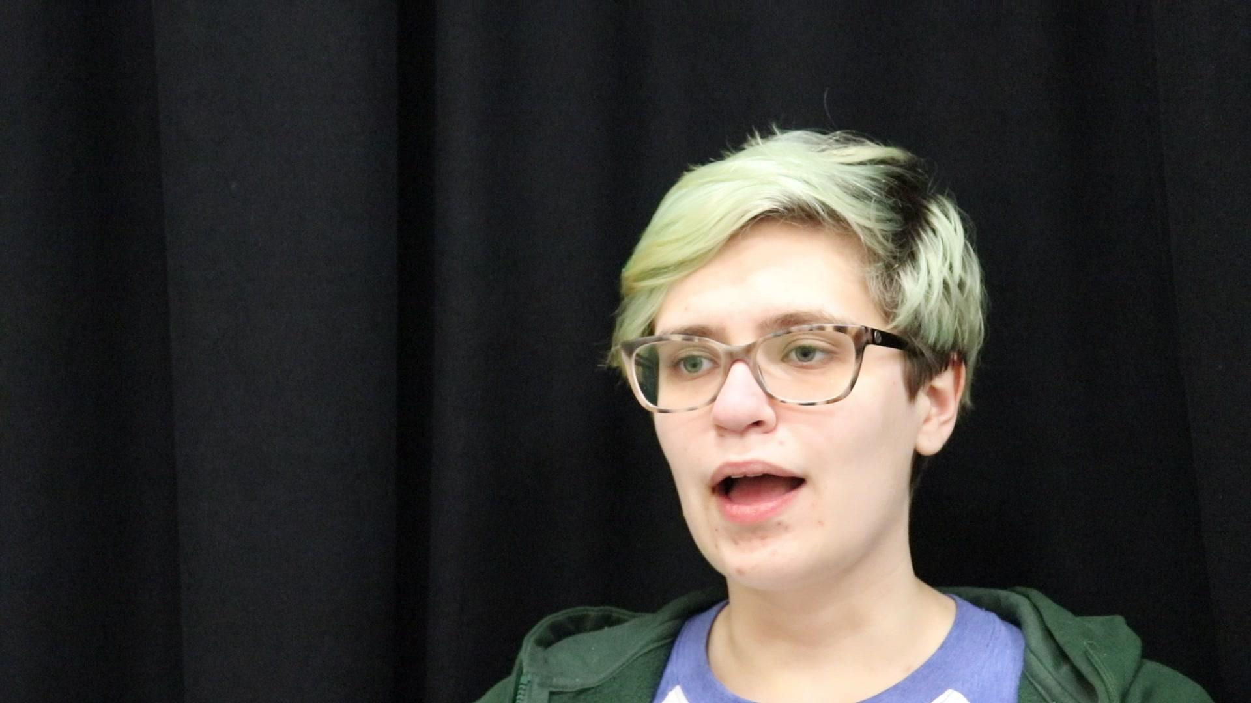
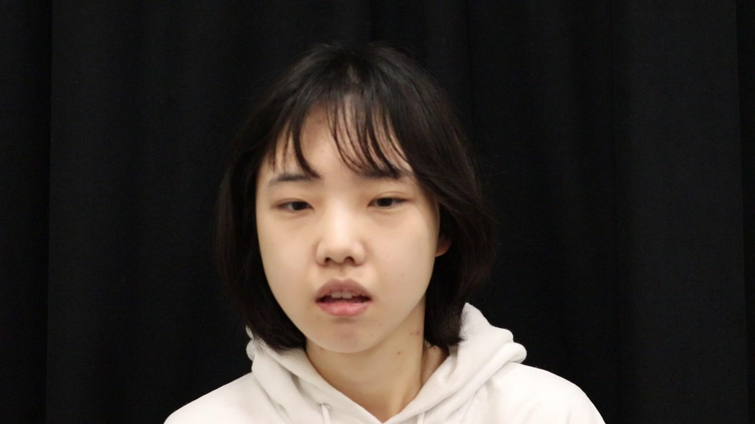
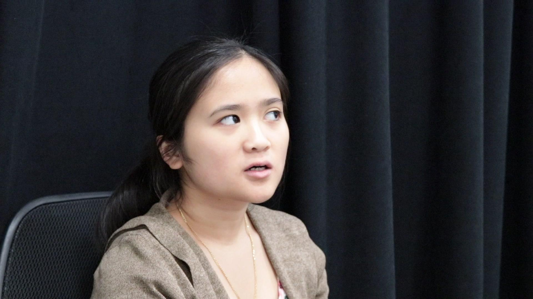
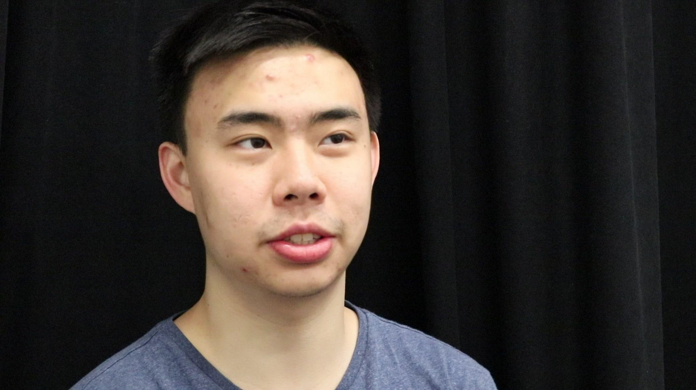
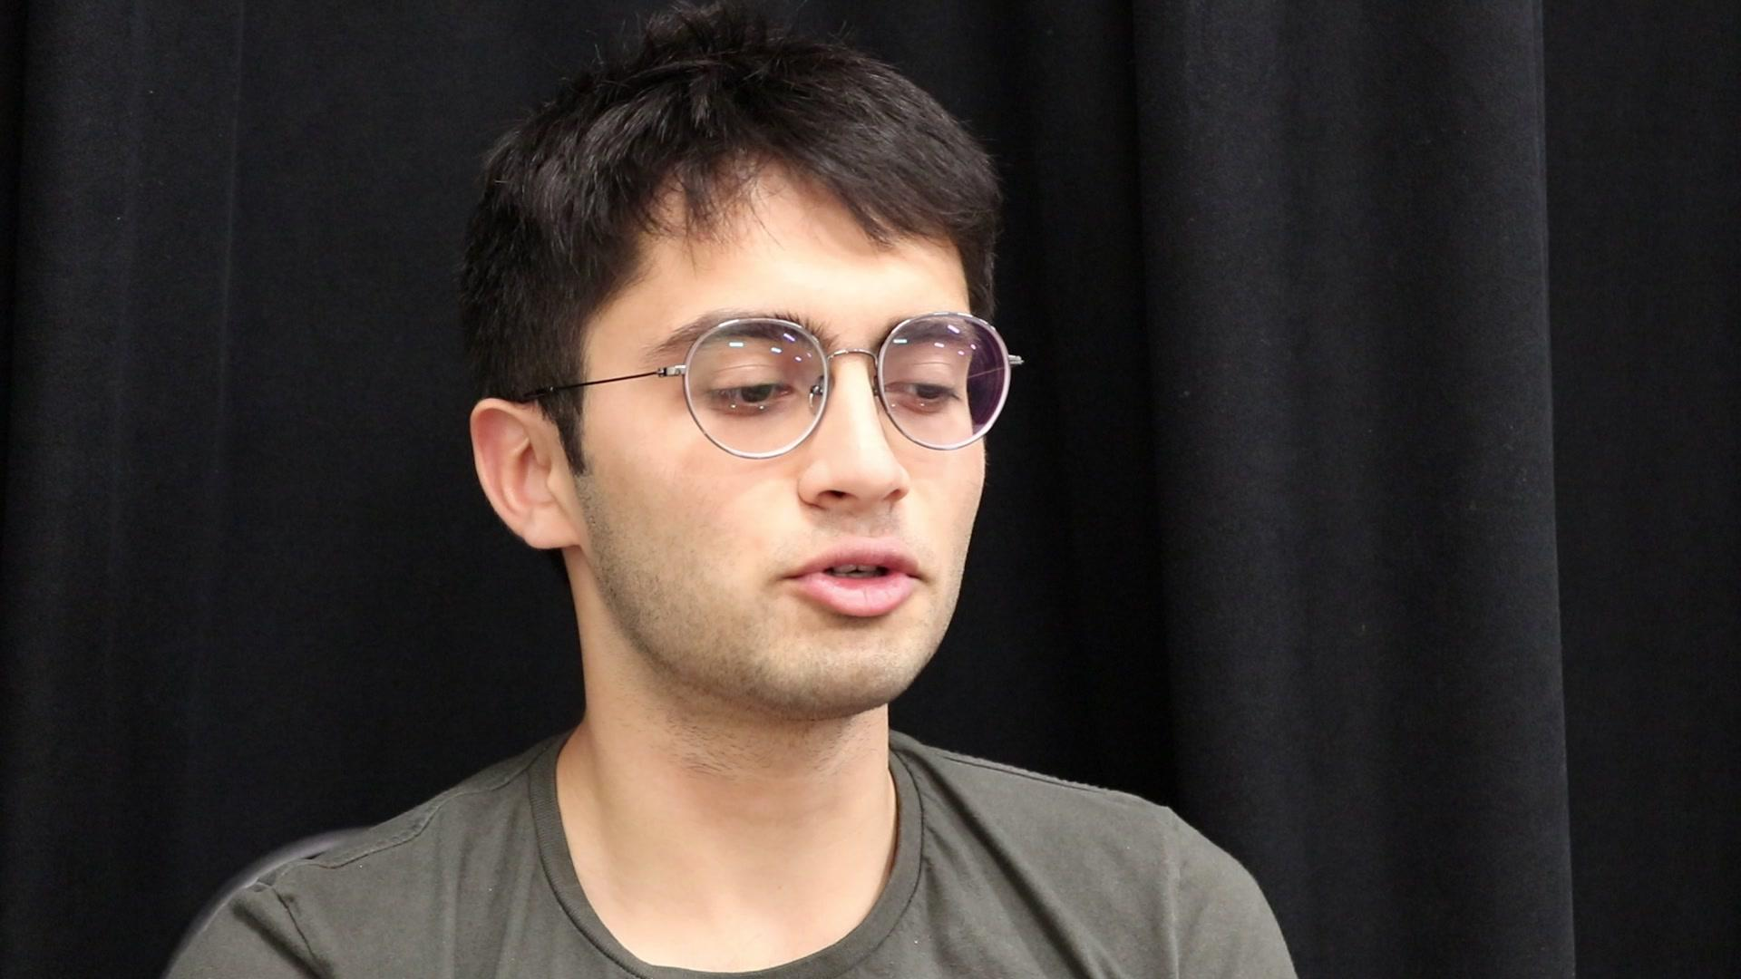
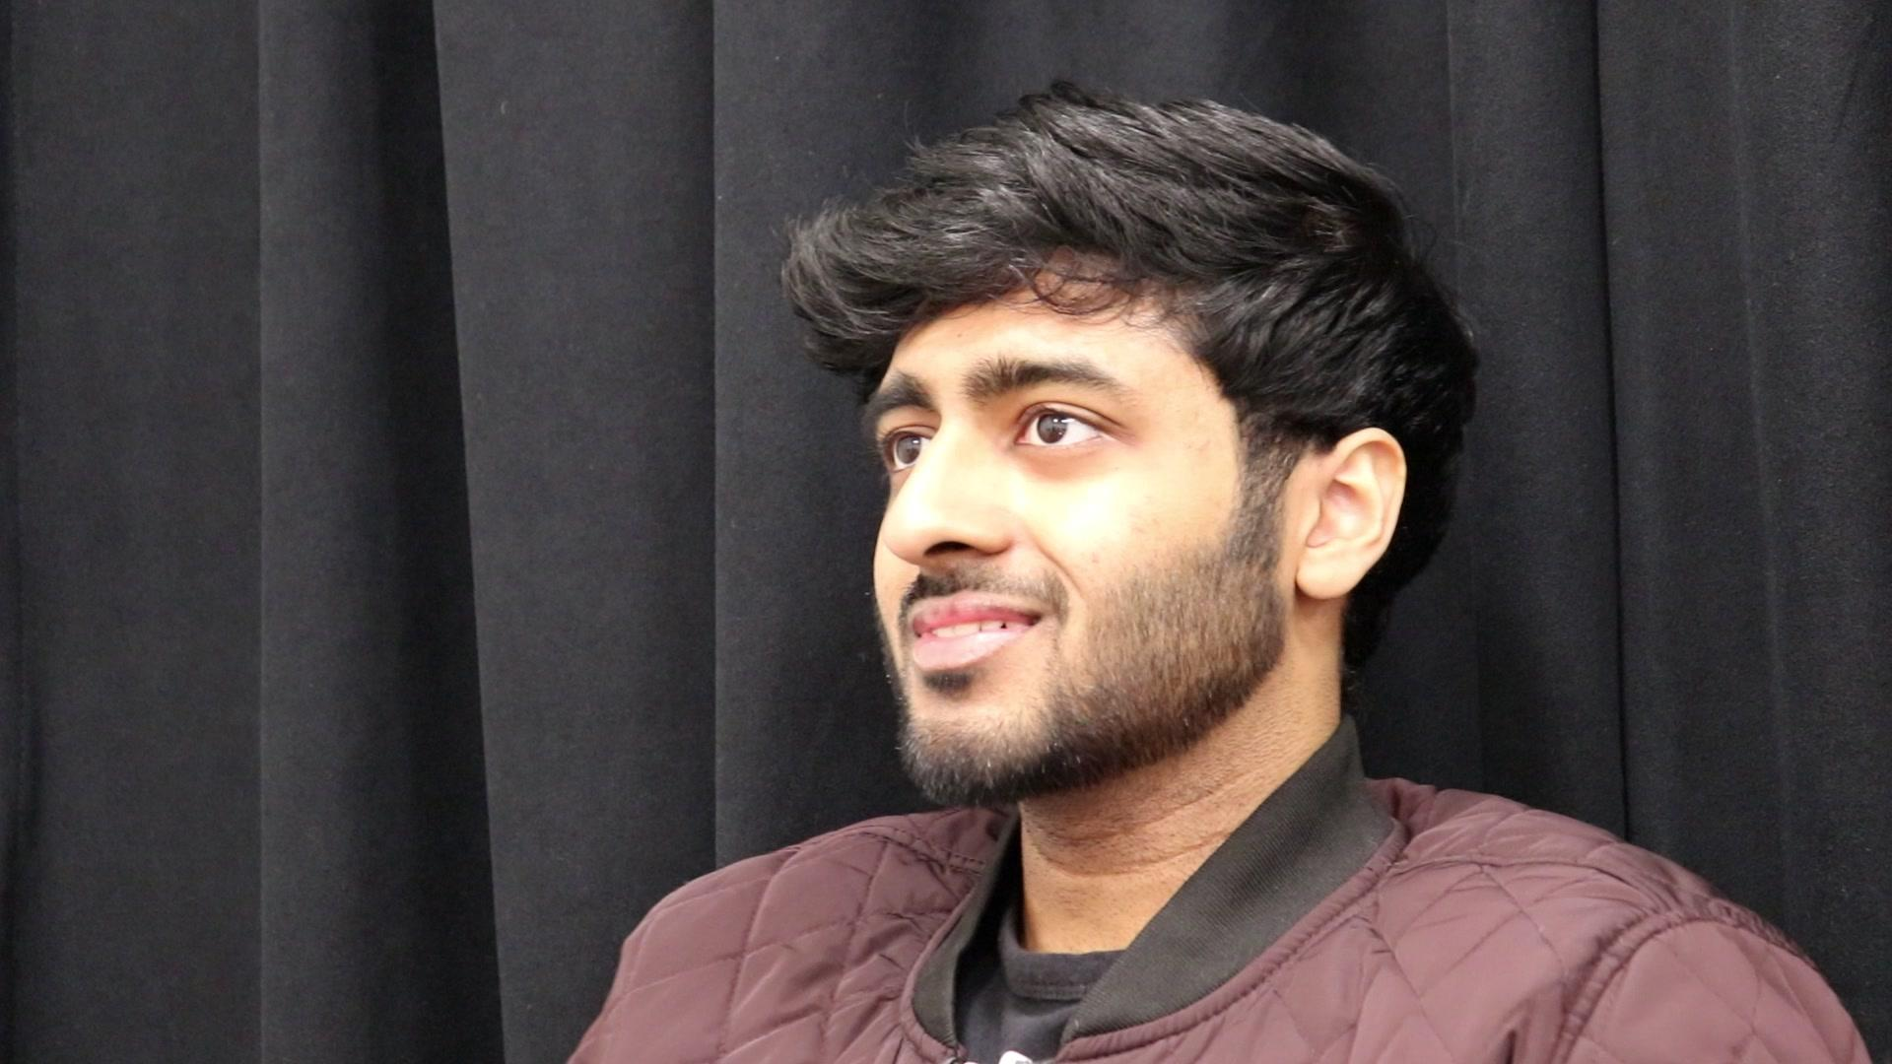
Notes:
To evaluate our results, we capture multiview video of 25 speaking participants.

Slide 33
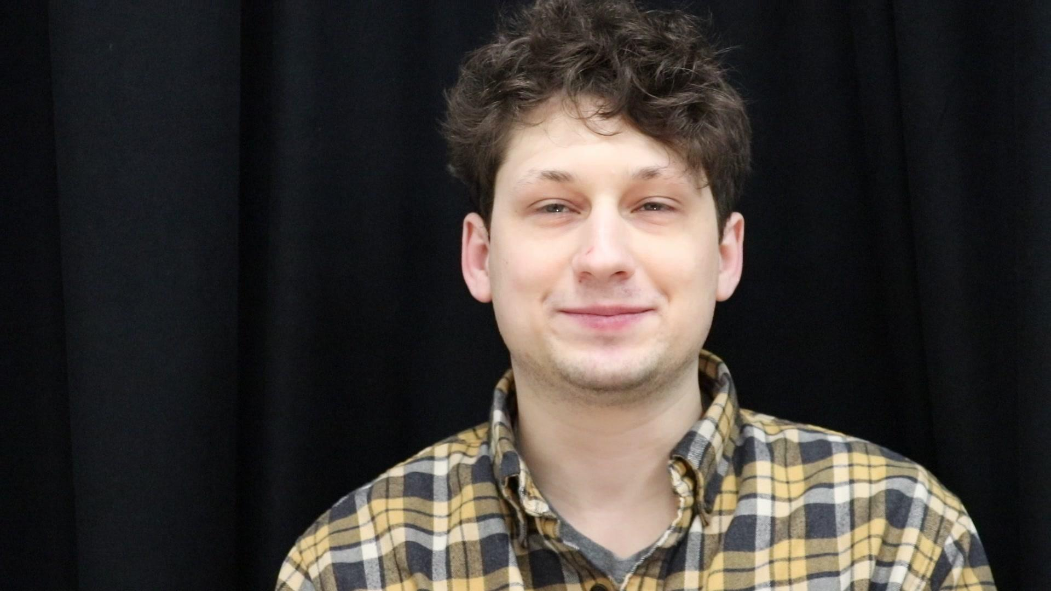
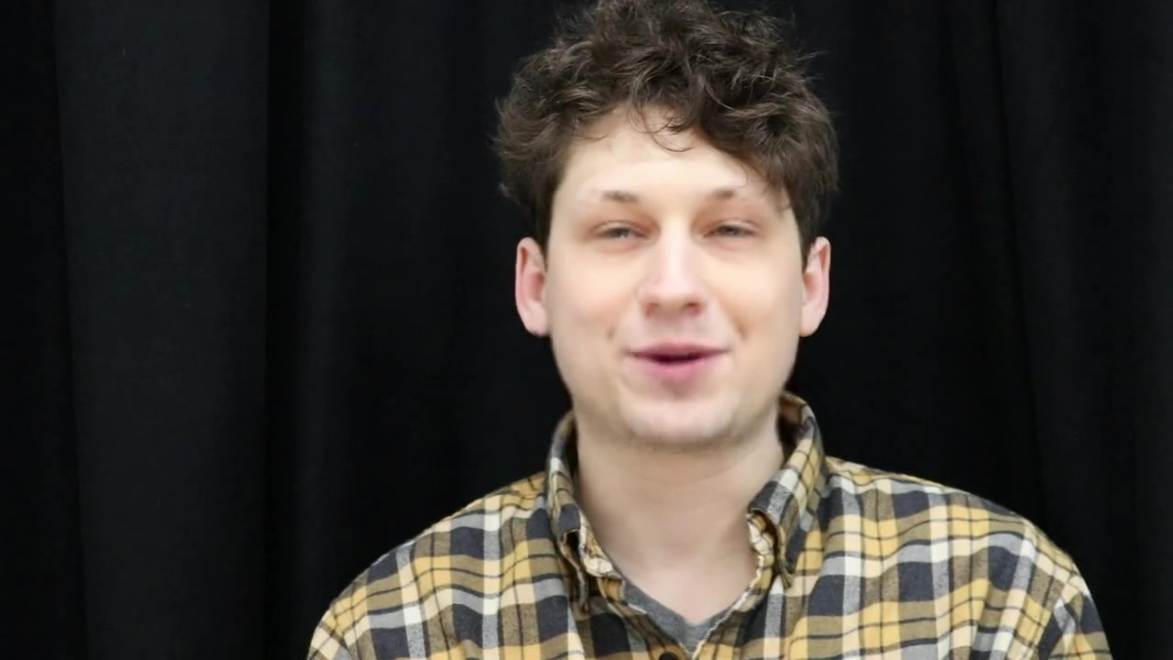
Fake creation via LipGAN
LipGAN by Prajwal K R, et. al., ACM, 2019.
Notes:
We use LipGAN to generate deepfakes, which re-dubs the mouth motion of the participant to fit an audio track. Since our deepfake generator focuses on the mouth, we isolate our method to the mouth landmarks.

Slide 34
Evaluating Deepfake Detection
Video Inputs:
{6 Real, 0 Fake}
{5 Real, 1 Fake}
{4 Real, 2 Fakes}
{3 Real, 3 Fakes}
Each fake:
LipGAN Output
Original Video
LipGAN Output
time
Notes:
For evaluation, we create four sets of video inputs per participant. We interleave the fake video with its real counterpart, so that the fake will correspond with the real videos for certain timeframes.

Slide 35
Evaluating Deepfake Detection: Baselines
Simple measure of mouth “openness.”
Discrete wavelet transform (DWT) of landmarks through time.
Notes:
We establish two baselines for comparison. In the first, we use a simple landmark-based measure of how ‘open’ the mouth is, then hierarchically cluster the results. In the second, we perform a discrete wavelet transform on the matrix of normalized landmarks through time, avoiding PCA entirely, then hierarchically cluster the resulting wavelet coefficients.

Slide 36
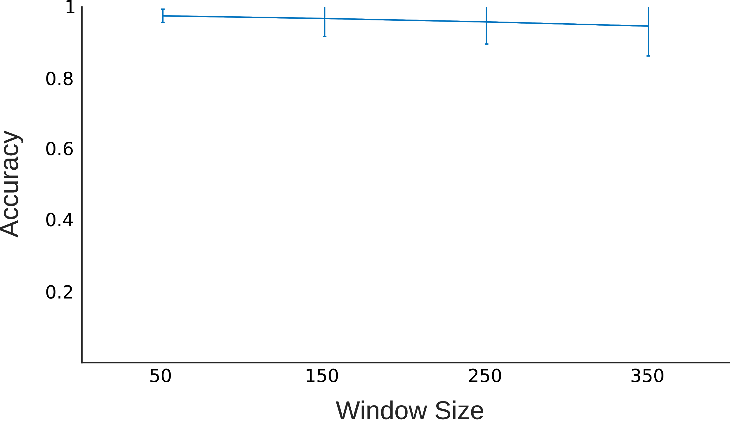
Evaluating Deepfake Detection
Detection Accuracy vs Window Size
Ours
Input: {6 Reals, 0 Fakes}
Window sizes: 50 to 350 frames
Notes:
Using a sliding window through time, we find that our method’s accuracy remains high in the no-fake case for various window sizes.

Slide 37
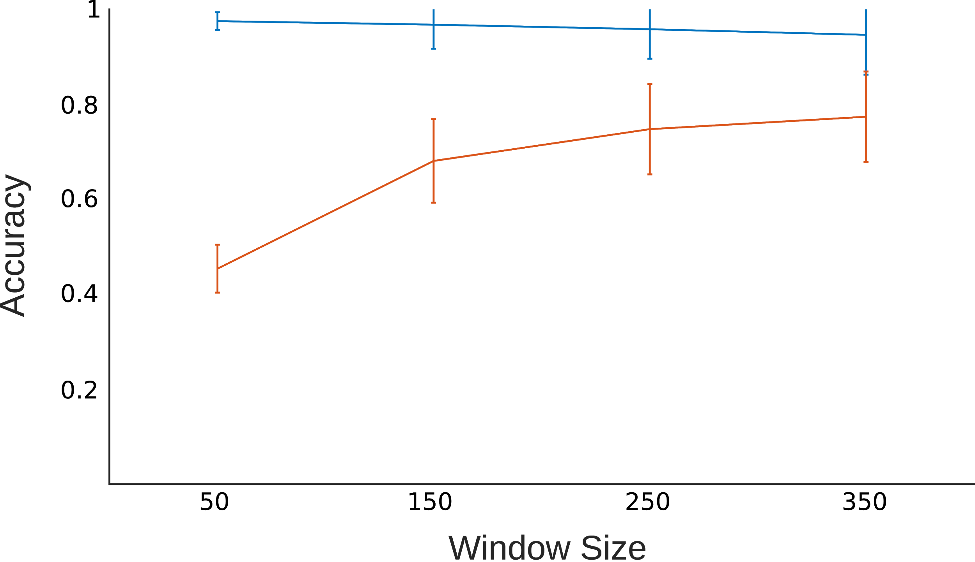
Evaluating Deepfake Detection
Detection Accuracy vs Window Size
Ours
Input: {6 Reals, 0 Fakes}, {5 Reals, 1 Fake}
Window sizes: 50 to 350 frames
Notes:
Our accuracy decays as the number of fakes increases.

Slide 38
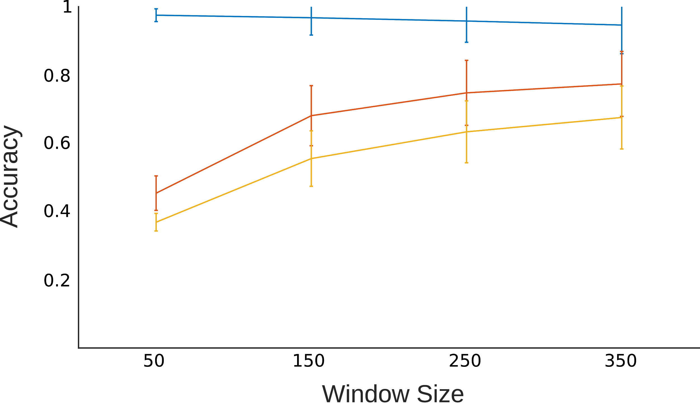
Evaluating Deepfake Detection
Detection Accuracy vs Window Size
Ours
Input: {6 Reals, 0 Fakes}, {5 Reals, 1 Fake}, {4 Reals, 2 Fakes}
Window sizes: 50 to 350 frames
Notes:
Our accuracy decays as the number of fakes increases.

Slide 39
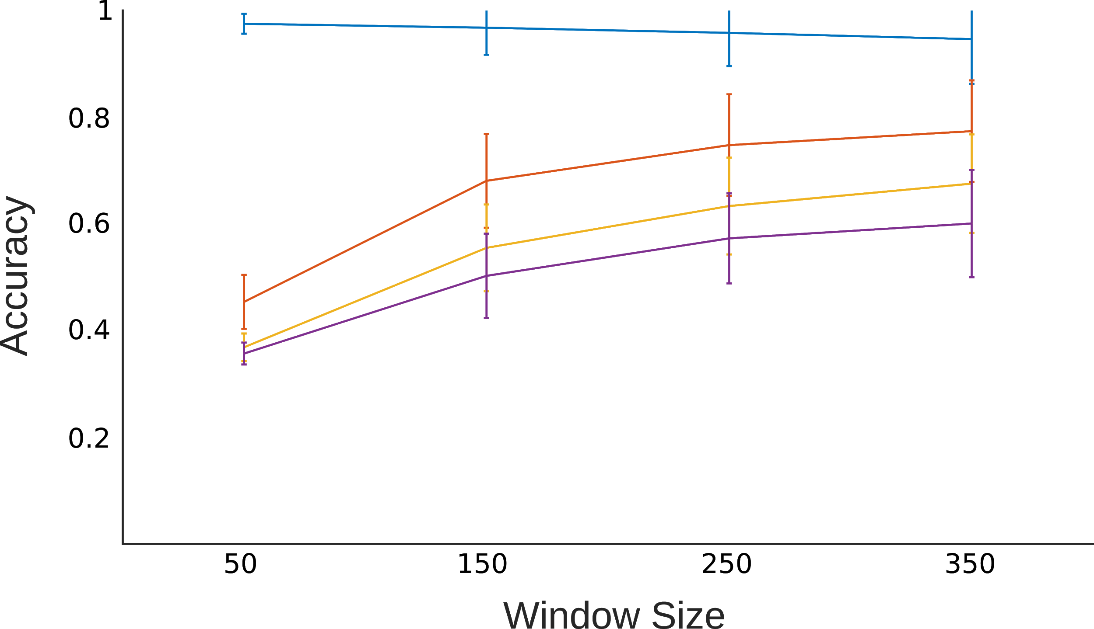
Evaluating Deepfake Detection
Detection Accuracy vs Window Size
Ours
Input: {6 Reals, 0 Fakes}, {5 Reals, 1 Fake}, {4 Reals, 2 Fakes}, {3 Reals, 3 Fakes}
Window sizes: 50 to 350 frames
Notes:
Our accuracy decays as the number of fakes increases.

Slide 40
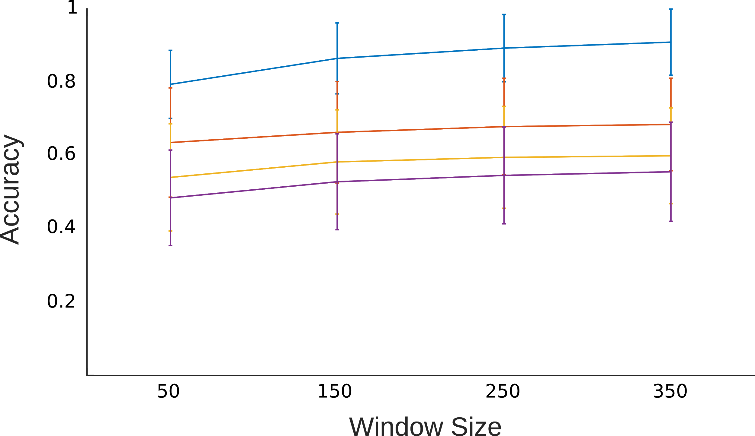
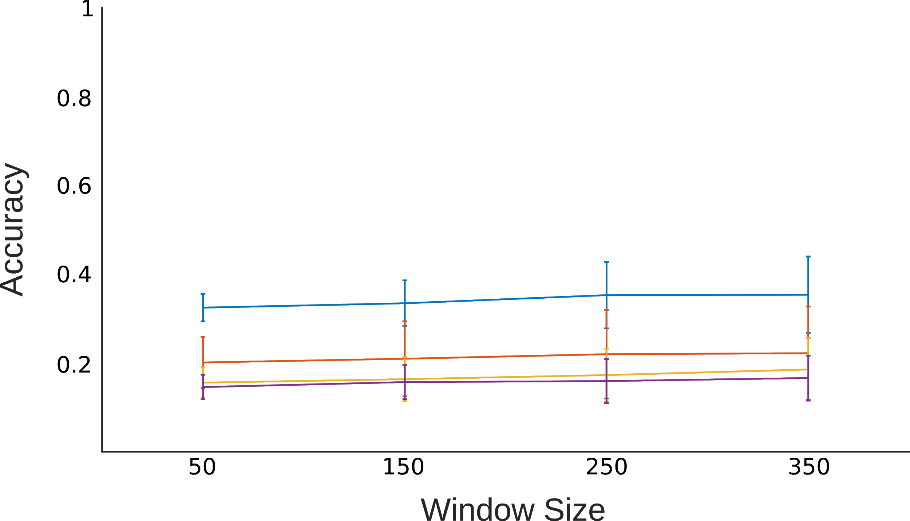
Evaluating Deepfake Detection
Detection Accuracy vs Window Size
Ours
DWT
Simple Mouth
Input: {6 Reals, 0 Fakes}, {5 Reals, 1 Fake}, {4 Reals, 2 Fakes}, {3 Reals, 3 Fakes}
Window sizes: 50 to 350 frames
Notes:
We dramatically outperform the simple mouth baseline. While we only somewhat outperform the discrete wavelet transform baseline,

Slide 41
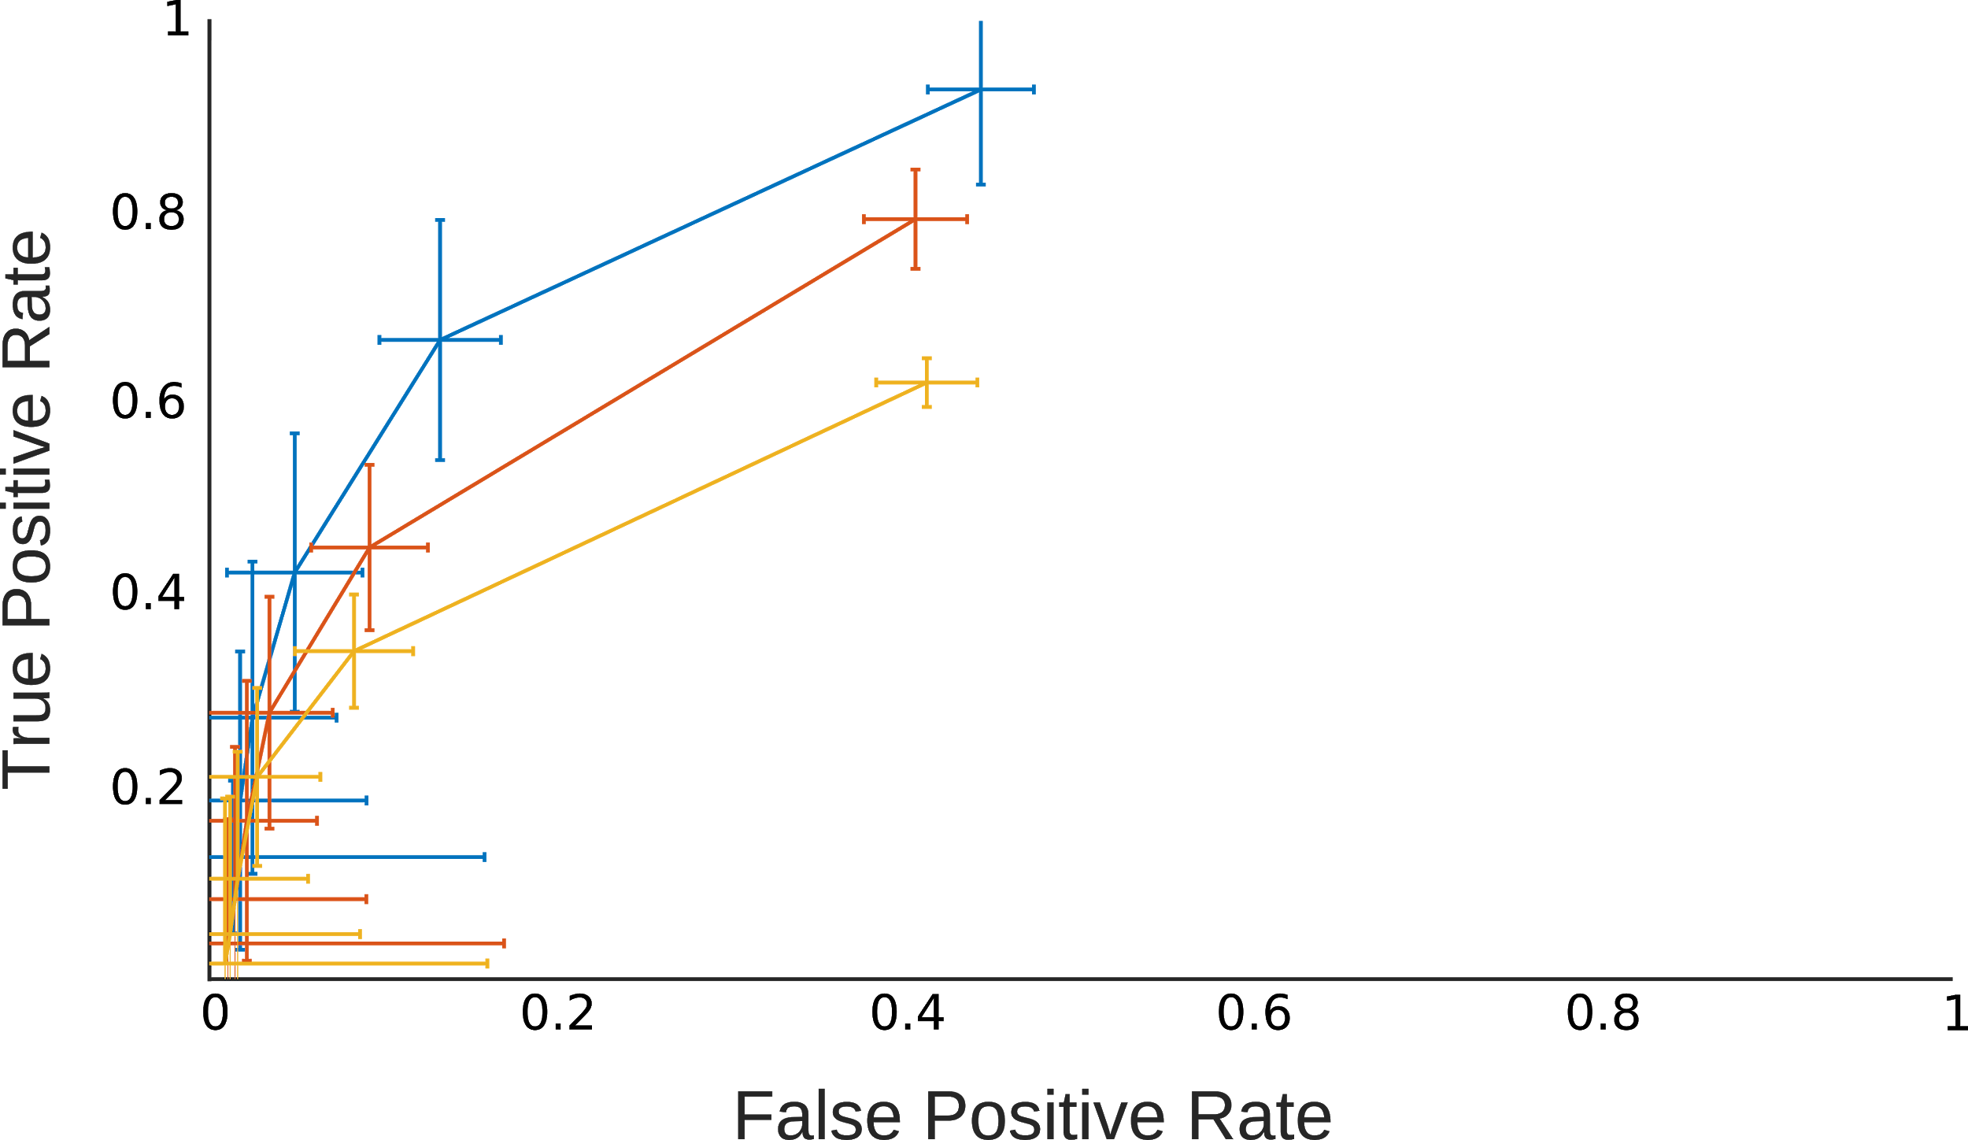
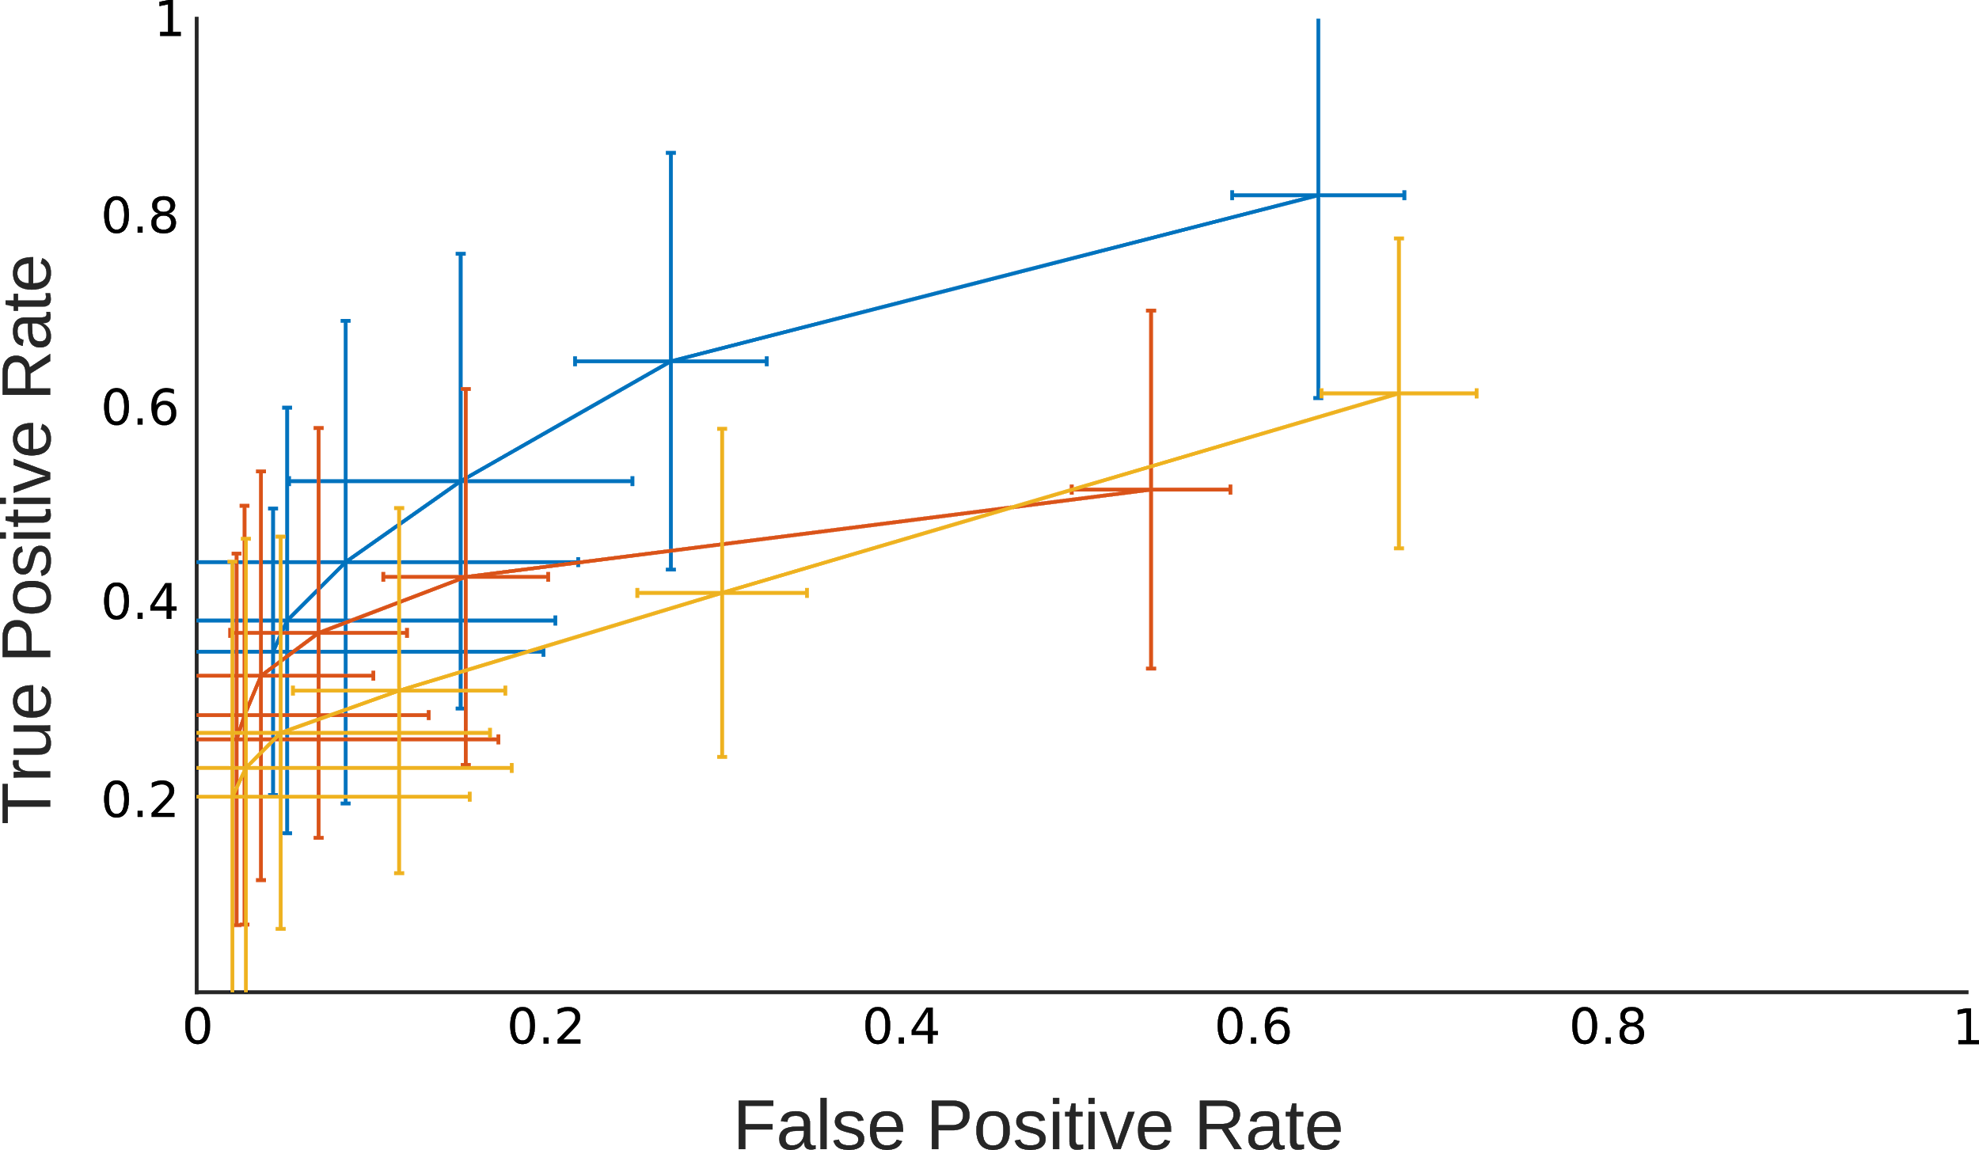
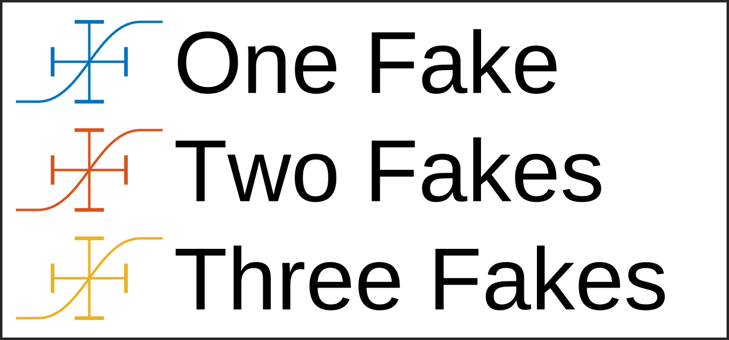
Evaluating Deepfake Detection
ROC Curves
Ours
DWT
Window size: 250 frames
Notes:
the baseline’s false positive rate is dramatically higher.

Slide 42
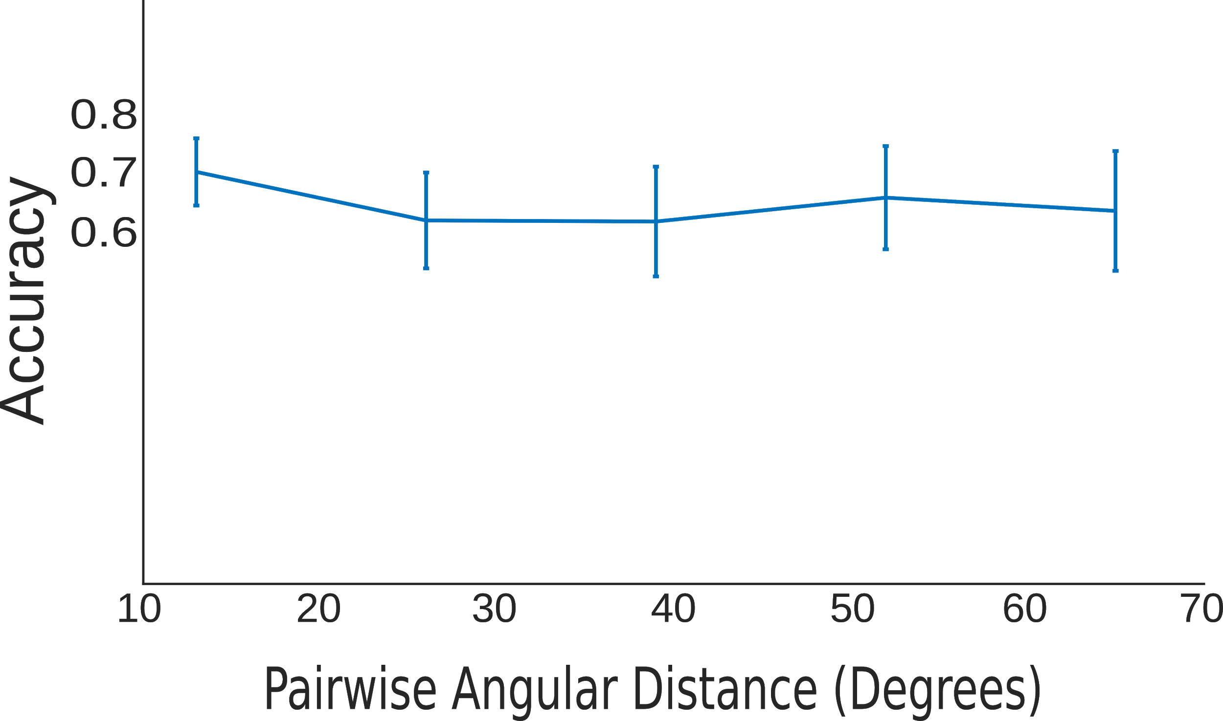
Evaluating Pose Invariance
Detection Accuracy vs Pairwise Angular Distance
Video input: {2 Real, 1 Fake}
Notes:
We find that our method is robust to angular camera separation of up to 65 degrees by calculating fake detection accuracy over pairs of cameras grouped by their real-world angular distance.

Slide 43
Social Video Verification
Notes:
We present social video verification, a new setup for deepfake detection, and a simple, fast-to-compute 2D landmark-based consensus metric for facial appearance across views. Moving forward, we seek to implement social video verification on a set of smartphones. We also plan to explore more expensive geometric representations as possible consensus metrics.

Slide 44
Please contact us if you are interested in this project!
https://visual.cs.brown.edu/socialvideoverification
We’d like to extend a big thank you to:
Jessica Forde and Kweku Kwegyir-Aggrey for initial explorations,
Purvi Goel, Naveen Srinivasan, and Natalie Lindsay for data collection and snacks, and
NVIDIA for donating a GPU.
Notes:
If this work interests you, please reach out to us. We are actively seeking collaborators for this project. Thank you to everyone who has contributed to the work so far, and thank you for your time.

