Slide 1
Notes:
< This slide exists for a reason: It provides a fade-in from white for the first slide. Otherwise, Powerpoint will fade in from black. >

Slide 2
How might we improve a predictor after it has been trained
and without having access to
the original training data or labels?
Notes:
How might we improve a predictor _after_ it has been trained <ADVANCE>
and _without_ having access to the original training data or labels?

Slide 3





Testing Using Privileged Information
By Adapting Features with Statistical Dependence
Kwang In Kim
James Tompkin
South Korea
USA
Notes:
Hello - I’m James Tompkin, an assistant professor at Brown University, and I’m here with my dear colleague Kwang In Kim, from Ulsan National Institute of Science and Technology.

Slide 5
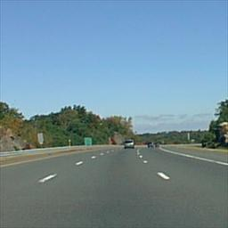
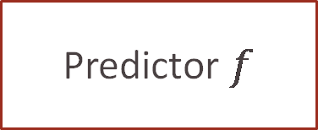
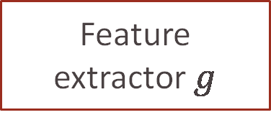
Feature
extractor $g$
Predictor $f$
“Road”
Notes:
Consider the classic visual analysis pipeline:
Given an image, we use a feature extractor g to provide information upon which a predictor f produces an answer.

Slide 6

Training
Testing
DB
Feature
extractor $g$
Feature
extractor $g$
Predictor $f$
Predictor $f$
“Road”
“Road”
Labels
Notes:
We assume that the feature extractors available <ADVANCE> at training time are equivalent to those available at testing time.
Attributions:
- Testing road image – William Warby “Desert Road” CC BY 2.0 - https://www.flickr.com/photos/wwarby/9638435181

Slide 7
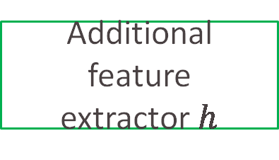
Learning using privileged information (LUPI)
Vapnik and Izmailov, JMLR 2015
Training
Testing
DB
Feature
extractor $g$
Additional feature
extractor $h$
Feature
extractor $g$
Predictor $f$
Predictor $f$
“Road”
“Road”
Labels
Notes:
Vapnik and Izmailov assumed <ADVANCE> additional features h that are _not_ available at testing time.
They called these features “privileged information”, and so developed <ADVANCE> a method for learning using privileged information --- or ‘LUPI’
<ADVANCE> + slide change
-------
SKIP
This situation might occur when:
the additional feature extractor is too computationally expensive to use in testing, say, if it required additional hardware.
Or if the features themselves are proprietary

Slide 8
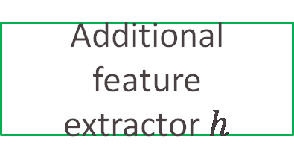
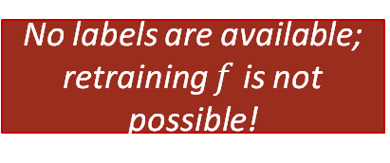
Testing using privileged information (TUPI)
Training
Testing
DB
Feature
extractor $g$
Feature
extractor $g$
Additional feature
extractor $h$
Predictor $f$
Predictor $f$
“Road”
“Road”
Labels
No labels are available; retraining $f$ is not possible!
Notes:
We propose the complementary problem of *testing using privileged information* --- or, ‘TUPI’
<ADVANCE>
Here, we have new privileged information as additional features at test time.
TUPI is critically different from LUPI in that, as is usual in testing, <ADVANCE> no labels are available, and so retraining the predictor f using the additional features is not possible!
<slide change> Furthermore, …

Slide 9
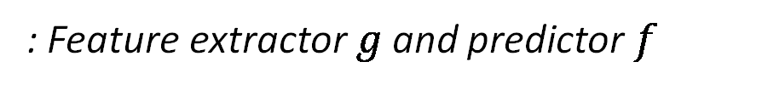


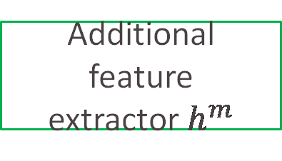
Testing using privileged information (TUPI)
Training
: Feature extractor $g$ and predictor $f$
Testing
DB
Feature
extractor $g$
Feature
extractor $g$
Additional feature
extractor $h$
Additional feature
extractor $h^{m}$
$$⋯$$
$${}^{1}$$
Predictor $f$
Predictor $f$
“Road”
“Road”
Labels
Notes:
…we might have <ADVANCE> m different privileged test-time features.
Even though we hope that each is useful, we don’t know that they are –
Any solution must select which features (if any) are useful without degrading the performance of the predictor f.

Slide 11



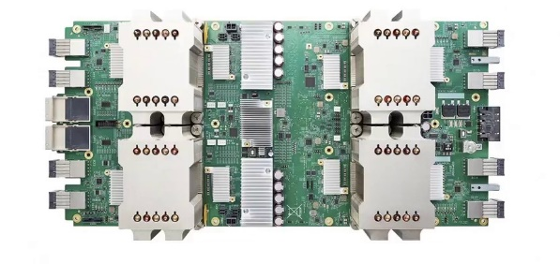
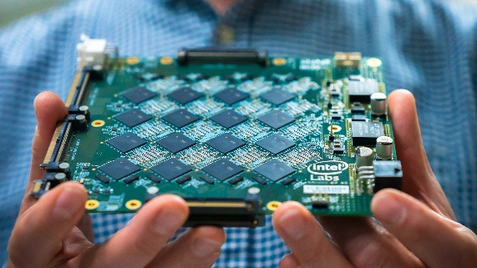

TUPI scenarios are more common than you might think!
Proprietary training data
Predictor-as-a-service
Expensive training
Specialized hardware
TPUs
Neuromorphic
Notes:
TUPI scenarios are more common than you might think!
First, if training labels or data are proprietary.
For instance, if big tech provides a predictor-as-a-service, but a small company has additional information.
< ADVANCE >
Second, if the training process is prohibitively expensive or requires specialized hardware like TPUs or FPGAs.
Images:
- US Small Business Administration - https://www.sba.gov/size-standards
© Google - TPUs
© Intel - https://www.redsharknews.com/technology-computing/item/7092-intel-is-building-a-brain-the-size-of-a-planet

Slide 12


TUPI scenarios are more common than you might think!
Proprietary training data
Predictor-as-a-service
Expensive training
Specialized hardware
TPUs
Neuromorphic
Restricted training data
Information security and privacy
Training data no longer available
Transient data
DB
james@gpuserver: /$ rm –rf .
Notes:
Third, if training labels or data are restricted, such predictors trained on high security or private information.
< ADVANCE >
And Fourth, if data or labels are no longer available. Say, the data are so numerous or large as to be ‘transient’ because storing them is impossible.
Another example is when, uh, a faculty member accidentally deletes all the grad student’s data on the GPU server (!) <ADVANCE> - but - we promise this wasn’t the motivation for developing this technique. ; )
Images:
- US Small Business Administration - https://www.sba.gov/size-standards
© Google - TPUs
© Intel - https://www.redsharknews.com/technology-computing/item/7092-intel-is-building-a-brain-the-size-of-a-planet
Pixabay - https://pixabay.com/illustrations/europe-gdpr-data-privacy-3220208/
The Noun Project - https://thenounproject.com/search/?q=data+privacy&i=1772590 - Data privacy policy by Juraj Sedlák from the Noun Project

Slide 14
Transfer learning
Predictors from other tasks as test-time features
Requires known predictor form
Other task
predictors
Target predictor
Notes:
You might be thinking:
“If the test-time privileged information is a predictor from a different task, then TUPI would sound like transfer learning…”
TUPI is related, but distinct. Transfer learning typically assumes that the form of the predictor is the same.
But, if one predictor is a neural network and another is a support vector machine, then it is unclear how to transfer.
In the TUPI problem, the form is not assumed and so the problem is more general.

Slide 15
Transfer learning
Predictors from other tasks as test-time features
Requires known predictor form
Other task
predictors
Target predictor
Semi-supervised learning
Graph Laplacian to propagate few labels
Still requires some labels
Notes:
You might also be thinking:
“Rather than no labels, if I just had _a few_ labels at test time then TUPI would sound like semi-supervised learning….”
That’s right. Given just a few labels, we could propagate labels across neighbors in trained and privileged feature space.
However, in the TUPI problem, we have no labels.

Slide 17
CoConut: Co-Classification with Output Space Regularization
Khamis and Lampert, BMVC 2014
Linear classification using training time features
Graph Laplacian-based refinement using test-time features
Complementary to our assumption and approach
Notes:
In CoConut, Khamis and Lampert perform output label space regularization to prefer certain class proportions by refinement via a graph Laplacian local neighborhood structure.
They took the required pairwise distances from the training-time features, but if we take the distances from test-time features then this approach can apply to the TUPI problem.
Their assumption that neighborhood smoothness can improve predictor performance is actually complementary to our approach.

Slide 19
Our fundamental assumption:
Useful privileged information will exhibit
a strong statistical dependence with
a hypothesized perfect predictor.
Notes:
Our fundamental assumption is that
“Useful privileged information will exhibit a strong statistical dependence with a hypothesized perfect predictor.”
So, why might statistical dependence be a good assumption?

Slide 21
Ideal feature
Privileged information directly correlates with perfect predictor
Useful feature
Privileged information scale or sign still correlates
Useless feature
Privileged information inde-pendent from perfect predictor
Perfect
predictor
Perfect
predictor
Perfect
predictor
Privileged information
Privileged information
Privileged information
Considers every point in dataset, rather than local neighborhood structure
Notes:
Suppose the privileged information feature were ideal, then it would exactly correlate with the perfect predictor.
< ADVANCE >
Similarly, suppose the privileged information were useless, then it would be independent from the perfect predictor.
< ADVANCE >
We might expect the privileged information to be somewhat useful – perhaps its scale or even just its sign correlates with the perfect predictor.
< ADVANCE >
In each case, statistical dependence considers every point in the dataset holistically, rather than the local neighborhood structure.

Slide 23
1. Linear to non-linear multi-dimensional
Perfect
predictor
Privileged information
Notes:
We will use two tools in our algorithm.
First, statistical dependence measures like Pearson’s correlation coefficient are only valid for linear relationships.
We might expect the relationship between the privileged information and our perfect predictor to be nonlinear.

Slide 24
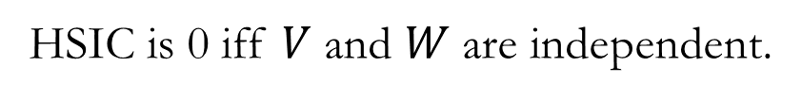


1. Linear to non-linear multi-dimensional
Hilbert-Schmidt Independence Criterion (HSIC)
Gretton et al., ALT 2005
A high-order measure of statistical dependence.
Perfect
predictor
Datasets $V=\left\{v_{1},…,v_{N}\right\}$
$$W=\left\{w_{1},…,w_{N}\right\}$$
HSIC is 0 iff $V$ and $W$ are independent.
Privileged information
Notes:
< ADVANCE >
As such, we will use a kernel method – the Hilbert-Schmidt Independence Criterion or HSIC – to describe non-linear statistical dependence.
This can detect arbitrary dependencies on random variables, no matter their form.
< ADVANCE >
Suppose we have two datasets V and W sampled from their probability distributions.
< ADVANCE >
HSIC is zero if and only if the underlying random variables of V and W are independent. This is a required criterion for a statistical dependence measure.

Slide 25
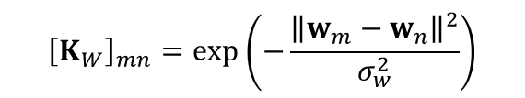
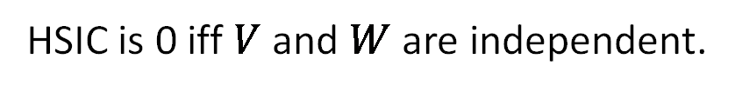
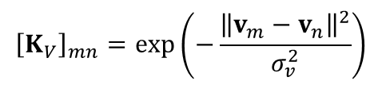
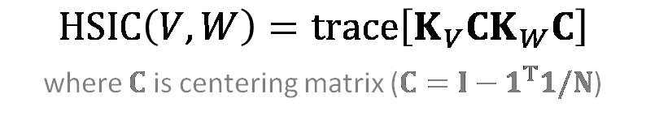


1. Linear to non-linear multi-dimensional
Hilbert-Schmidt Independence Criterion (HSIC)
Gretton et al., ALT 2005
A high-order measure of statistical dependence.
Perfect
predictor
Datasets $V=\left\{v_{1},…,v_{N}\right\}$
$$W=\left\{w_{1},…,w_{N}\right\}$$
HSIC is 0 iff $V$ and $W$ are independent.
Kernel evaluation matrices:
$${\left[K_{V}\right]}_{mn}=exp\left(−\frac{{\left\|v_{m}−v_{n}\right\|}^{2}}{σ_{v}^{2}}\right)$$
$${\left[K_{W}\right]}_{mn}=exp\left(−\frac{{\left\|w_{m}−w_{n}\right\|}^{2}}{σ_{w}^{2}}\right)$$
$HSIC\left(V,W\right)=trace\left[K_{V}CK_{W}C\right]$
where $C$is centering matrix ($C=I−1^{T}1/N$)
Privileged information
Notes:
To compute HSIC, we first calculate the kernel evaluation matrices using Gaussians of both V <ADVANCE, pause> and W.
< ADVANCE >
Then, we align the corresponding kernel matrices via the centering matrix.
This gives us a finite sample-based estimation of the statistical dependence of the underlying random variables V and W.

Slide 26

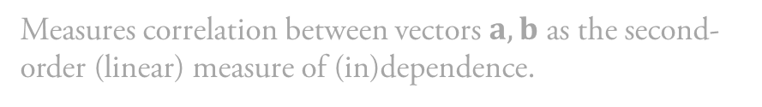
1. Linear to non-linear multi-dimensional
Hilbert-Schmidt Independence Criterion (HSIC)
Gretton et al., ALT 2005
A high-order measure of statistical dependence.
Perfect
predictor
$$Linear HSIC\left(a,b\right)={\left(\frac{a^{T}b}{\left\|a\right\|\left\|b\right\|}\right)}^{2}$$
Measures correlation between vectors $a,b$ as the second-order (linear) measure of (in)dependence.
Non-linearizing (kernelizing) linear HSIC gives a high-order dependence measure for multi-dimensional objects.
Privileged information
Notes:
As a side note, if we use linear kernels, then HSIC provides a measure for linear dependences.

Slide 27
2. Perfect to imperfect
Perfect
predictor
Privileged information
Notes:
Second, we can never observe the perfect predictor at test time because we do not have labels.
Instead, we will consider the output from our predictor f to be noisy predictions of the true perfect predictor.

Slide 28
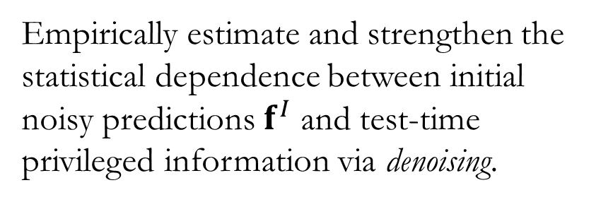
2. Perfect to imperfect
A high-dimensional denoising algorithm
Manifold denoising, Hein and Meier, NeurIPS 2007
Imperfect noisy initial
predictor
Empirically estimate and strengthen the statistical dependence between initial noisy predictions $f^{I}$ and test-time privileged information via denoising.
Privileged information
Notes:
Then, we will employ a high-dimensional denoising algorithm.
This will empirically estimate and strengthen the statistical dependence between the initial noisy predictor and the test-time privileged information via denoising.

Slide 29
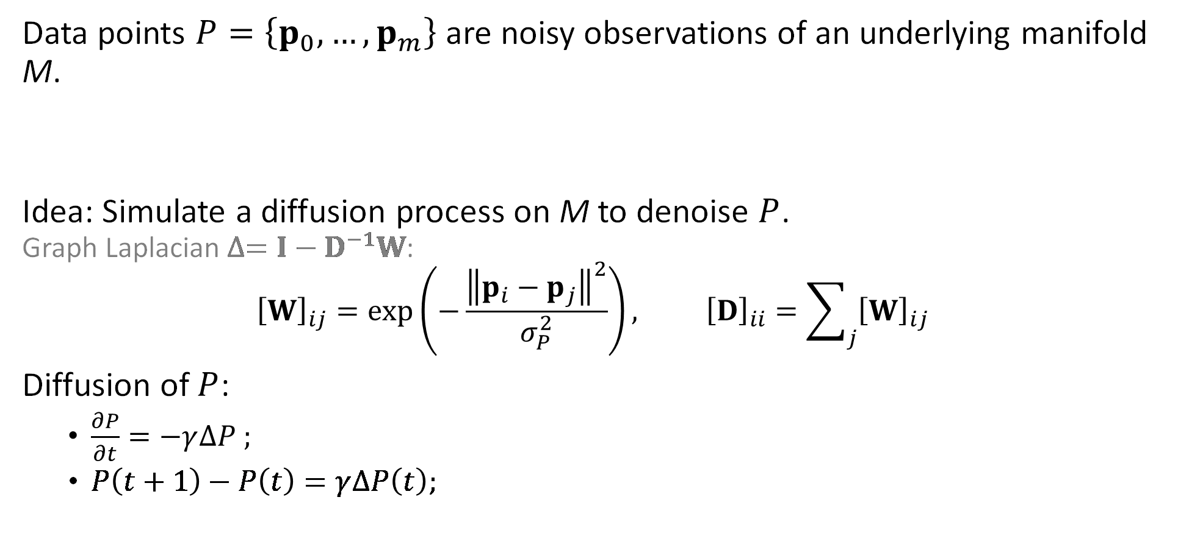
Manifold denoising (Hein and Meier, 2007)
Data points $P=\left\{p_{0},…,p_{m}\right\}$ are noisy observations of an underlying manifold M.
Idea: Simulate a diffusion process on M to denoise $P$.
Graph Laplacian $∆=I−D^{−1}W$:
$${\left[W\right]}_{ij}=exp\left(−\frac{{\left\|p_{i}−p_{j}\right\|}^{2}}{σ_{P}^{2}}\right), {\left[D\right]}_{ii}=\sum_{j}{{\left[W\right]}_{ij}}$$
Diffusion of $P$:
  $\frac{∂P}{∂t}=−γ∆P ;$
  $P\left(t+1\right)−P\left(t\right)=γ∆P\left(t\right);$
Notes:
Hein and Meier’s algorithm supposes that we have data points P as noisy observations of an underlying manifold M.
< ADVANCE >
Their idea is to simulate a diffusion process on M to denoise P. We construct the generator of the diffusion process as a graph Laplacian based on pairwise similarities W of individual data points.
< ADVANCE >
Then, denoising of P is given as an iterative time-discretization obtained based on implicit Euler scheme.

Slide 31
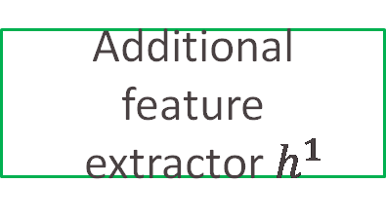


TUPI by Adapting Features with Statistical Dependence
Training
: Feature extractor $g$ and predictor $f$
Testing
Feature
extractor $g$
Additional feature
extractor $h^{1}$
Additional feature
extractor $h^{m}$
$$⋯$$
$$H^{1}=\left\{h_{1}^{1},…,h_{1}^{1}\right\}$$
$$H^{m}=\left\{h_{1}^{m},…,h_{1}^{m}\right\}$$
Predictor $f$
“Road”
Notes:
So, let’s go back to the diagram of our TUPI problem statement, and use the idea of adapting features with statistical dependence.
First, let’s declare our test-time privileged feature sets as H^1 to H^m

Slide 32
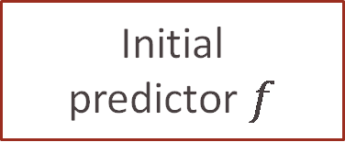

TUPI by Adapting Features with Statistical Dependence
Training
: Feature extractor $g$ and predictor $f$
Testing
Feature
extractor $g$
Additional feature
extractor $h^{1}$
Additional feature
extractor $h^{m}$
$$⋯$$
$$H^{1}=\left\{h_{1}^{1},…,h_{1}^{1}\right\}$$
$$H^{m}=\left\{h_{1}^{m},…,h_{1}^{m}\right\}$$
Initial
predictor $f$
“Road”
$$f^{I}=\left\{f\left(g_{1}\right),…,f\left(g_{n}\right)\right\}$$
Notes:
We’re going to treat the trained predictor f as an initial predictor that produces a set of predictions f^I,

Slide 33

TUPI by Adapting Features with Statistical Dependence
Training
: Feature extractor $g$ and predictor $f$
Testing
Feature
extractor $g$
Additional feature
extractor $h^{1}$
Additional feature
extractor $h^{m}$
$$⋯$$
$$H^{1}=\left\{h_{1}^{1},…,h_{1}^{1}\right\}$$
$$H^{m}=\left\{h_{1}^{m},…,h_{1}^{m}\right\}$$
Initial
predictor $f$
Optimized predictor
Statistical dependence
feature adaptation
$$f^{I}=\left\{f\left(g_{1}\right),…,f\left(g_{n}\right)\right\}$$
$$f^{O}=\left\{f_{1}^{O},…,f_{n}^{O}\right\}$$
Notes:
And then we’re going to use HSIC and manifold denoising to adapt features to produce an optimized prediction f^O.

Slide 34
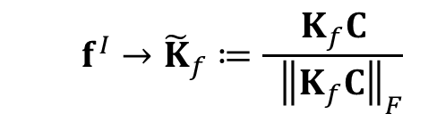

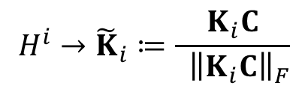
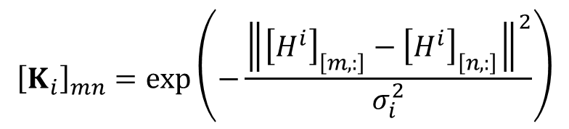
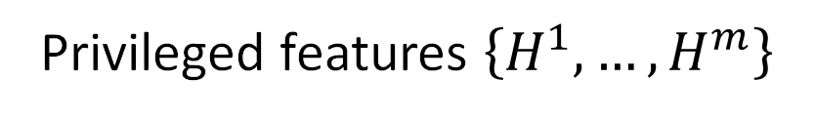
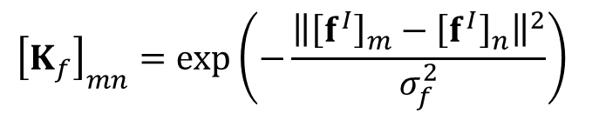

HSIC
for TUPI denoising
Initial predictor $f^{I}$
Privileged features $\left\{H^{1},…,H^{m}\right\}$
Kernel evaluation matrices:
$${\left[K_{i}\right]}_{mn}=exp\left(−\frac{{\left\|{\left[H^{i}\right]}_{\left[m,:\right]}−{\left[H^{i}\right]}_{\left[n,:\right]}\right\|}^{2}}{σ_{i}^{2}}\right)$$
$${\left[K_{f}\right]}_{mn}=exp\left(−\frac{{\left\|{\left[f^{I}\right]}_{m}−{\left[f^{I}\right]}_{n}\right\|}^{2}}{σ_{f}^{2}}\right)$$
Model space M embedding (space of normalized kernels)
  $$f^{I}→{\tilde{K}}_{f}≔\frac{K_{f}C}{ { \left\|K_{f}C\right\|}_{F}}$$
$$H^{i}→{\tilde{K}}_{i}≔\frac{K_{i}C}{{ \left\|K_{i}C\right\|}_{F}}$$
Similarity measure on M:
  $${\left\langle {\tilde{K}}_{f},{\tilde{K}}_{i}\right\rangle }_{M}=trace\left[{\tilde{K}}_{f}{\tilde{K}}_{i}\right]$$
  Is HSIC of the predictor $f$ and privileged feature $H^{i}\text{!}$
Notes:
Specifically, <ADVANCE>
Given our initial predictor f and features H, <ADVANCE> we define the corresponding kernel matrix evaluations K_f and K_i using Gaussian kernels as before.
<ADVANCE>
Then, we obtain our manifold embedding by casting the predictor and privileged features to their normalized kernel matrices.
< ADVANCE >
In this case, the natural similarity measure on the manifold is given in the form of the inner-product between kernel matrices.
< ADVANCE >
This is precisely HSIC between the predictor f and privileged features H^i when we consider them as samples from random variables.

Slide 36
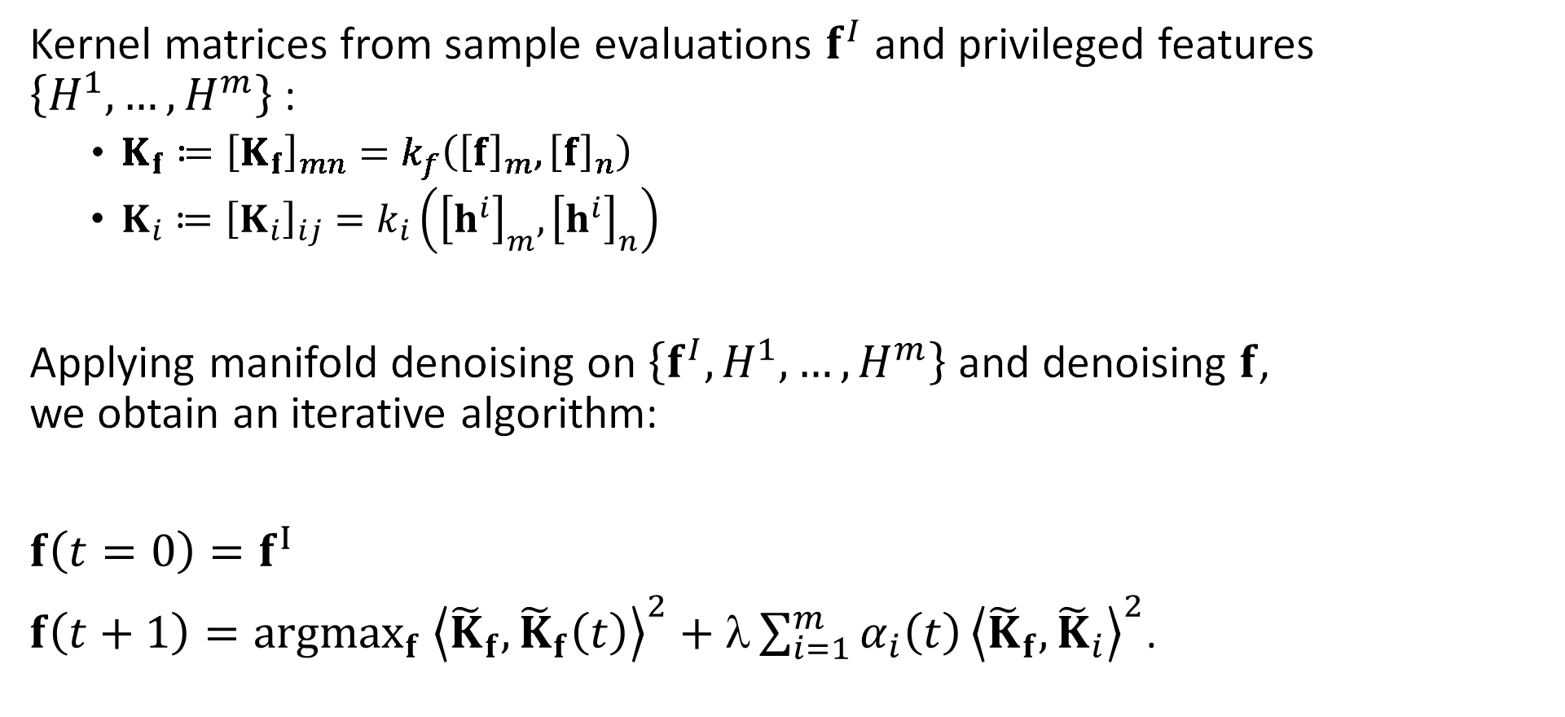
Our TUPI algorithm
Kernel matrices from sample evaluations $f^{I}$ and privileged features $\left\{H^{1},…,H^{m}\right\}$:
  $K_{f}≔{\left[K_{f}\right]}_{mn}=k_{f}\left({\left[f\right]}_{m},{\left[f\right]}_{n}\right)$
  $K_{i}≔{\left[K_{i}\right]}_{ij}=k_{i}\left({\left[h^{i}\right]}_{m},{\left[h^{i}\right]}_{n}\right)$
Applying manifold denoising on $\left\{f^{I},H^{1},…,H^{m}\right\}$ and denoising $f$,
we obtain an iterative algorithm:
$f\left(t=0\right)=f^{I}$
$f\left(t+1\right)={argmax}_{f} {\left\langle {\tilde{K}}_{f},{\tilde{K}}_{f}\left(t\right)\right\rangle }^{2}+λ\sum_{i=1}^{m}{α_{i}\left(t\right)}{\left\langle {\tilde{K}}_{f},{\tilde{K}}_{i}\right\rangle }^{2}$.
Notes:
%In practice, we won’t be able to integrate the predictor and feature extractor functions directly. Instead, we improve the sample evaluations. The corresponding kernel matrices are given as K_f and K_i.
Now we can apply manifold denoising to our predictor and feature manifold given as an iterative update rule of the sample evaluation f:
Our algorithm iteratively enforces the similarity with respect to the kernel matrices constructed from the predictors and privileged features.

Slide 37





Our TUPI algorithm
Applying manifold denoising on $\left\{f^{I},H^{1},…,H^{m}\right\}$ via an iterative algorithm:
$$h^{2}$$
$$f^{I}$$
$$h^{2}$$
$$h^{4}$$
$$h^{3}$$
Notes:
Now we can apply manifold denoising to our predictor and feature manifold via an iterative algorithm:

Slide 38



Our TUPI algorithm
Applying manifold denoising on $\left\{f^{I},H^{1},…,H^{m}\right\}$ via an iterative algorithm:
$$f^{O}\left(t=0\right)=f^{I}$$
$$h^{2}$$
$$f^{O}$$
$$h^{2}$$
$$h^{4}$$
$$h^{3}$$
Notes:
At t = 0, the predictor estimate is equal to the initial predictor

Slide 39

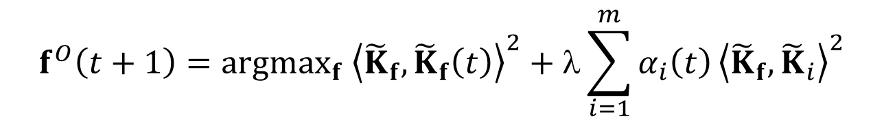
Our TUPI algorithm
Applying manifold denoising on $\left\{f^{I},H^{1},…,H^{m}\right\}$ via an iterative algorithm:
$$f^{O}\left(t+1\right)={argmax}_{f} {\left\langle {\tilde{K}}_{f},{\tilde{K}}_{f}\left(t\right)\right\rangle }^{2}+λ\sum_{i=1}^{m}{α_{i}\left(t\right)}{\left\langle {\tilde{K}}_{f},{\tilde{K}}_{i}\right\rangle }^{2}$$
$$h^{2}$$
$$f^{O}$$
$$h^{2}$$
$$h^{4}$$
$$h^{3}$$
Notes:
For each t + 1, our algorithm iteratively enforces similarity with respect to the kernel matrices constructed from predictor f and the privileged features.
< ADVANCE >
The similarity between f(0) and the privileged features are measured based on their HSIC values.

Slide 40





Our TUPI algorithm
Applying manifold denoising on $\left\{f^{I},H^{1},…,H^{m}\right\}$ via an iterative algorithm:
$$f^{O}\left(t+1\right)={argmax}_{f} {\left\langle {\tilde{K}}_{f},{\tilde{K}}_{f}\left(t\right)\right\rangle }^{2}+λ\sum_{i=1}^{m}{α_{i}\left(t\right)}{\left\langle {\tilde{K}}_{f},{\tilde{K}}_{i}\right\rangle }^{2}$$
$$h^{2}$$
$$α_{1}$$
$$f^{O}$$
$$h^{2}$$
$$α_{2}$$
$$α_{4}$$
$$h^{4}$$
$$α_{3}$$
$$h^{3}$$
Notes:
The magnitude of the corresponding parameter alpha is directly proportional to the corresponding HSIC values: Stronger statistically-dependent features are assigned with stronger weights.

Slide 41




Our TUPI algorithm
Applying manifold denoising on $\left\{f^{I},H^{1},…,H^{m}\right\}$ via an iterative algorithm:
$$f^{O}\left(t+1\right)={argmax}_{f} {\left\langle {\tilde{K}}_{f},{\tilde{K}}_{f}\left(t\right)\right\rangle }^{2}+λ\sum_{i=1}^{m}{α_{i}\left(t\right)}{\left\langle {\tilde{K}}_{f},{\tilde{K}}_{i}\right\rangle }^{2}$$
$$h^{2}$$
$$f^{O}$$
$$h^{2}$$
$$f^{O}$$
$$h^{4}$$
$$h^{3}$$
Notes:
Then, f at t+1 is obtained as a weighted average of f(t=0) and the privileged features.

Slide 42




Our TUPI algorithm
Applying manifold denoising on $\left\{f^{I},H^{1},…,H^{m}\right\}$ via an iterative algorithm:
$$f^{O}\left(t+1\right)={argmax}_{f} {\left\langle {\tilde{K}}_{f},{\tilde{K}}_{f}\left(t\right)\right\rangle }^{2}+λ\sum_{i=1}^{m}{α_{i}\left(t\right)}{\left\langle {\tilde{K}}_{f},{\tilde{K}}_{i}\right\rangle }^{2}$$
$$h^{2}$$
$$α_{1}$$
$$f^{O}$$
$$h^{2}$$
$$f^{O}$$
$$α_{2}$$
$$α_{4}$$
$$h^{4}$$
$$α_{3}$$
$$h^{3}$$
Notes:
Repeating this process tends to ignore irrelevant features as they are assigned with smaller weights.

Slide 43


Our TUPI algorithm
Applying manifold denoising on $\left\{f^{I},H^{1},…,H^{m}\right\}$ via an iterative algorithm:
$$f^{O}\left(t+1\right)={argmax}_{f} {\left\langle {\tilde{K}}_{f},{\tilde{K}}_{f}\left(t\right)\right\rangle }^{2}+λ\sum_{i=1}^{m}{α_{i}\left(t\right)}{\left\langle {\tilde{K}}_{f},{\tilde{K}}_{i}\right\rangle }^{2}$$
$$h^{2}$$
$$f^{O}$$
$$h^{2}$$
$$f^{O}$$
$$f^{O}$$
$$h^{4}$$
$$h^{3}$$

Slide 44
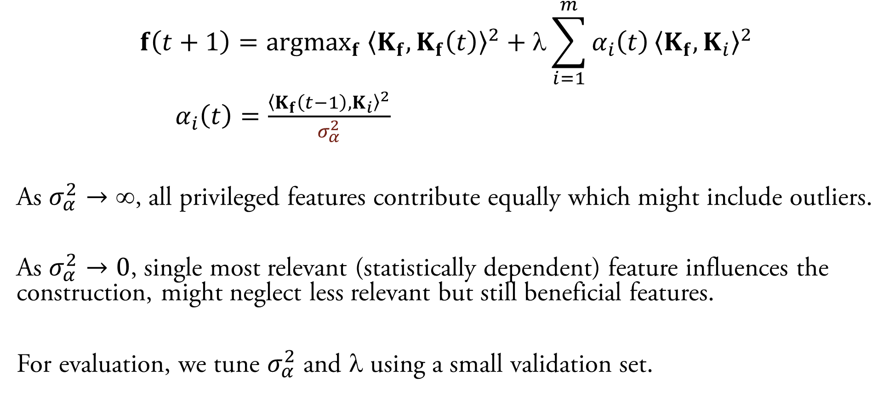
Effect of hyperparameters
$$f\left(t+1\right)={argmax}_{f} {\left\langle K_{f},K_{f}\left(t\right)\right\rangle }^{2}+λ\sum_{i=1}^{m}{α_{i}\left(t\right)}{\left\langle K_{f},K_{i}\right\rangle }^{2}$$
$α_{i}\left(t\right)=\frac{{\left\langle K_{f}\left(t−1\right),K_{i}\right\rangle }^{2}}{σ_{α}^{2}}$
As $σ_{α}^{2}→$, all privileged features contribute equally which might include outliers.
As $σ_{α}^{2}→0$, single most relevant (statistically dependent) feature influences the construction, might neglect less relevant but still beneficial features.
For evaluation, we tune $σ_{α}^{2}$ and $$ using a small validation set.
Notes:
Our algorithm has two hyperparameters sigma square and lambda. Lambda trades the contributions of the predictor kernels and the kernels from privileged features.
Sigma controls how uniform the contributions of features: As sigma square grows to infinity, all features contribute equally. This could include outliers.
On the other hand, as signa shrink down towards zero, it tends to focus on single most relevant feature, but it can neglect less relevant but still useful features.

Slide 46
Experimental Results
Notes:
So, let’s see some experimental results!

Slide 48
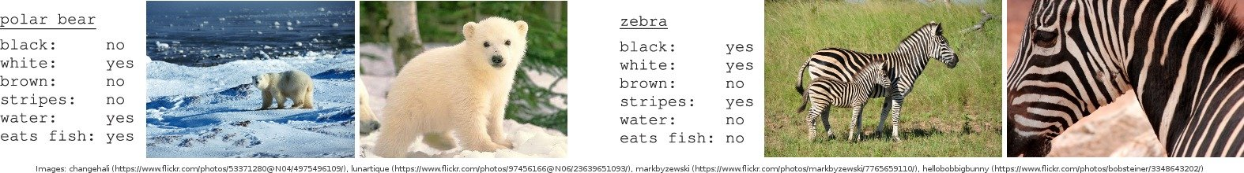


Animals with Attributes
Rank images of animals according to their attributes, e.g., stripes
$f\left( \right)>$ $f\left( \right)$
Initial features: Deep learned
(DeCAF, Donahue et al., 2014)
Privileged features: SURF, PHOG, VGG19
Notes:
We test our approach first on the Animals with Attributes dataset, where we try to rank images of animals according to, for example, how stripey they are.
<ADVANCE>
We use initial deep learned features, <ADVANCE> then provide privileged features of SURF, PHOG, and VGG19.
<ADVANCE>
You will notice that ‘classical’ SURF and PHOG features should be less useful than the deep learned VGG19 features.
<ADVANCE>
And, as expected, our approach selects to use the VGG19 features.
Images:
- https://cvml.ist.ac.at/AwA2/
Initial predictors for all experiments: Deep neural networks or RankSVM predictors
Datasets: OSR, Pubfig, Shoes datasets: initial predictor of an attribute improved by predictions of other attributes as privileged information.
InvDyn (inverse dynamics dataset): joint velocities as additional information.
AwA: DeCAF baseline feature extractor + SURF, PHOG, VGG19 privileged information.

Slide 49
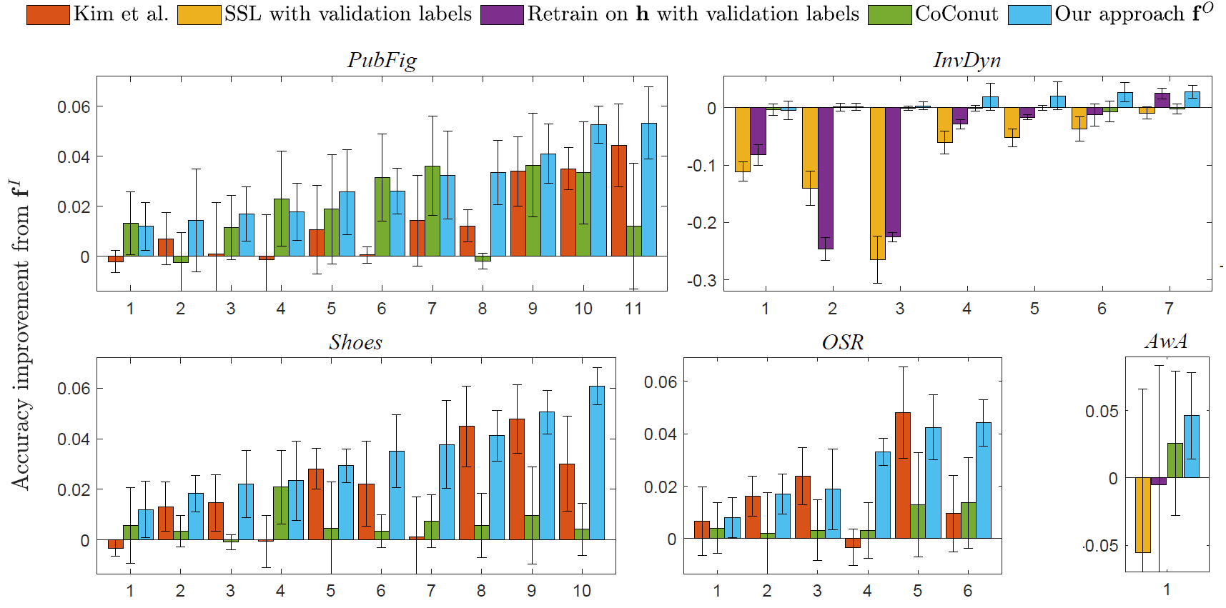
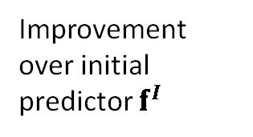
Animals with Attributes
Rank images of animals according to their attributes, e.g., stripes
$f\left( \right)>$ $f\left( \right)$
Average over 50 attributes
Initial features: Deep learned
(DeCAF, Donahue et al., 2014)
Semi-sup. learning with few labels
via graph Laplacian
5%
Privileged features: SURF, PHOG, VGG19
Improvement over initial predictor $f^{I}$
0%
-5%
Notes:
In terms of accuracy improvement over the initial predictor f, averaged over 50 animal attributes,
Using a few labels within semi-supervised learning has high variability, and generally decreases performance.
Images:
- https://cvml.ist.ac.at/AwA2/

Slide 50
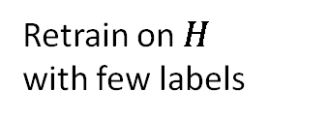
Animals with Attributes
Rank images of animals according to their attributes, e.g., stripes
$f\left( \right)>$ $f\left( \right)$
Average over 50 attributes
Initial features: Deep learned
(DeCAF, Donahue et al., 2014)
Semi-sup. learning with few labels
via graph Laplacian
5%
Privileged features: SURF, PHOG, VGG19
Improvement over initial predictor $f^{I}$
Retrain on $H$
with few labels
0%
-5%
Notes:
Using a few labels to retrain a new predictor given the privileged information also can increase or decrease performance.
Images:
- https://cvml.ist.ac.at/AwA2/

Slide 51
Animals with Attributes
Rank images of animals according to their attributes, e.g., stripes
$f\left( \right)>$ $f\left( \right)$
Average over 50 attributes
Initial features: Deep learned
(DeCAF, Donahue et al., 2014)
Semi-sup. learning with few labels
via graph Laplacian
5%
Privileged features: SURF, PHOG, VGG19
Improvement over initial predictor $f^{I}$
Retrain on $H$
with few labels
0%
CoConut
Khamis and Lampert 2014
-5%
Notes:
Khamis and Lampert’s CoConut on TUPI often improves performance but still has high variability.
Images:
- https://cvml.ist.ac.at/AwA2/

Slide 52
Animals with Attributes
Rank images of animals according to their attributes, e.g., stripes
$f\left( \right)>$ $f\left( \right)$
Average over 50 attributes
Initial features: Deep learned
(DeCAF, Donahue et al., 2014)
Semi-sup. learning with few labels
via graph Laplacian
5%
Privileged features: SURF, PHOG, VGG19
Improvement over initial predictor $f^{I}$
Retrain on $H$
with few labels
0%
CoConut
Khamis and Lampert 2014
-5%
Our approach
Notes:
Our approach consistently improves performance and, due to its selection of useful features, never decrease performance.
Images:
- https://cvml.ist.ac.at/AwA2/

Slide 53


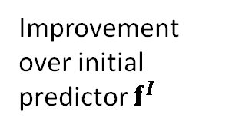
Shoe attribute ranking
Rank shoe formalness using privileged information from 9 other attribute ranks
$f\left( \right)>$ $f\left( \right)$
Shoes dataset – 10 shoe attributes
6%
Kim et al. ICCV 2017
(needs 1D predictor form)
Improvement over initial predictor $f^{I}$
4%
CoConut
Khamis and Lampert 2014
2%
Our approach
0%
1
2
3
4
5
6
7
8
9
10
Notes:
Next, let’s look at ranking shoes by their attributes, such as how formal a shoe is, across 10 attributes.
Here, the privileged features are the output rankings from predictors trained on the other 9 attributes – so a 1D predictor form.
< ADVANCE >
Kim et al.’s predictor combination method applies here, but our approach is consistently better and more reliable at using the privileged information.

Slide 54
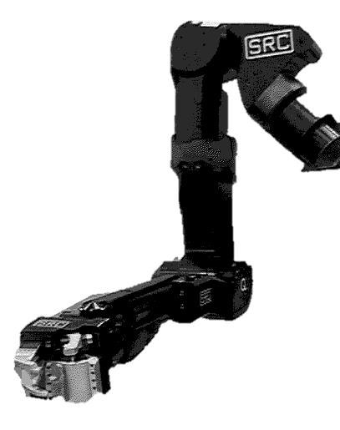
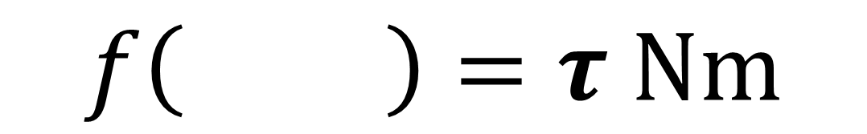
Robot motion
Estimate torque on 7 joints using 15 initial + 6 privileged velocity features
$$f\left( \right)=τ Nm$$
InvDyn dataset – 7 joints
Semi-sup. learning with few labels
via graph Laplacian
0%
Improvement over initial predictor $f^{I}$
-10%
Retrain on $H$
with few labels
-20%
CoConut
Khamis and Lampert 2014
-30%
Our approach
1
2
3
4
5
6
7
Notes:
We also attempt to estimate torque values for a robot arm using privileged information of velocity features.
Here, again we see the potential danger of retraining without being able to select useful features.
Our approach almost always improves the predictor.
InvDyn
45,000 data points
Each is 21 dimensional – 7 joint positions, velocities, and accelerations.
Given 15 randomly of these, estimate one of 7 different torque variables when also given the missing 6 variables as privileged information.

Slide 56
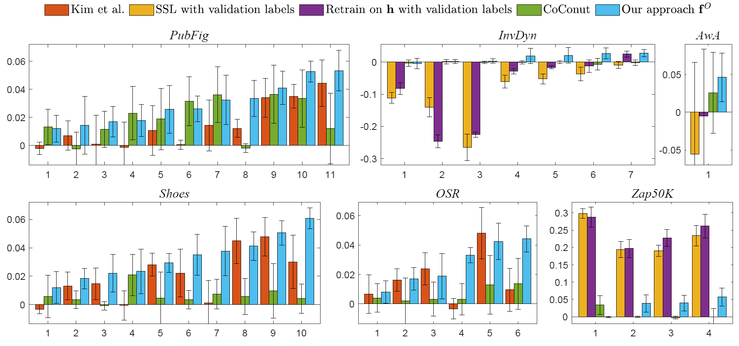

Given sufficiently powerful test-time features,
retraining with few labels can be better.
Zap50k dataset – shoe attributes
Semi-sup. learning with few labels
via graph Laplacian
30%
20%
Retrain on $H$
with few labels
10%
CoConut
0%
Our approach
1
2
3
4
Notes:
Of course, given sufficiently powerful test-time features, retraining with few labels can be better than our approach.
< ADVANCE >
As we might expect, using classical features for training but deep learned test-time features leads to this situation.

Slide 57
Statistical dependence can be combined
with local neighborhood structure.
Pubfig dataset – face attributes
6%
Ours + CoConut
4%
CoConut
2%
Our approach
0%
3
6
10
Notes:
Finally, one benefit is that statistical dependence can be combined with the local neighborhood structure idea from CoConut.
< ADVANCE >
Here in dark blue we minimize a shared objective that achieves greater performance gains than either method individually.

Slide 59



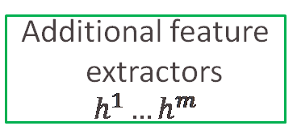


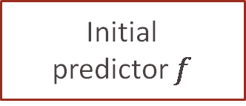

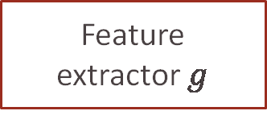

Testing Using Privileged Information
By Adapting Features with Statistical Dependence
Kwang In Kim
Testing
Reliably improves performance by selecting useful test-time features.
Applies to black-box predictors and test-time features of any form.
$$X=\left\{x_{1},…,x_{n}\right\}$$
Feature
extractor $g$
Additional feature
extractors $h^{1}…h^{m}$
$$G=\left\{g_{1},…,g_{n}\right\}$$
$$H^{1}…H^{m}$$
James Tompkin
Initial
predictor $f$
Our algorithm
Optimized
predictor
$$f^{I}=\left\{f\left(g_{1}\right),…,f\left(g_{n}\right)\right\}$$
$$f^{O}$$
Notes:
In conclusion, Testing using Privileged Information – or TUPI – is an interesting problem scenario.
To tackle it, we propose an algorithm to adapt test-time features via statistical dependence < ADVANCE >
- This reliably improves performance by selecting useful test-time features, unlike some examples we saw when retraining on few labels decreased performance < ADVANCE >
- And it applies to black box predictors and test-time features of any form, so it’s widely applicable – so, go and try it on your problem and let us know what you think!
< ADVANCE >
From Kwang In Kim and myself, James Tompkin, we hope you have a great ICCV!

Slide 61
Limitation: A simple failure case
Notes:
All results from main paper (Zap50K is limitation result)

Slide 62
References
[VI15] V. Vapnik and R. Izmailov. Learning using privileged information: similarity control and knowledge transfer, JMLR, 2015.
[GBS05] A. Gretton, O. Bousquet, A. Smola, and B. Schölkopf, Measuring statistical dependence with Hilbert-Schmidt norms, ALT, 2005.
[HM07] M. Hein and M. Maier, Manifold denoising, NeurIPS, 2007.

Slide 63
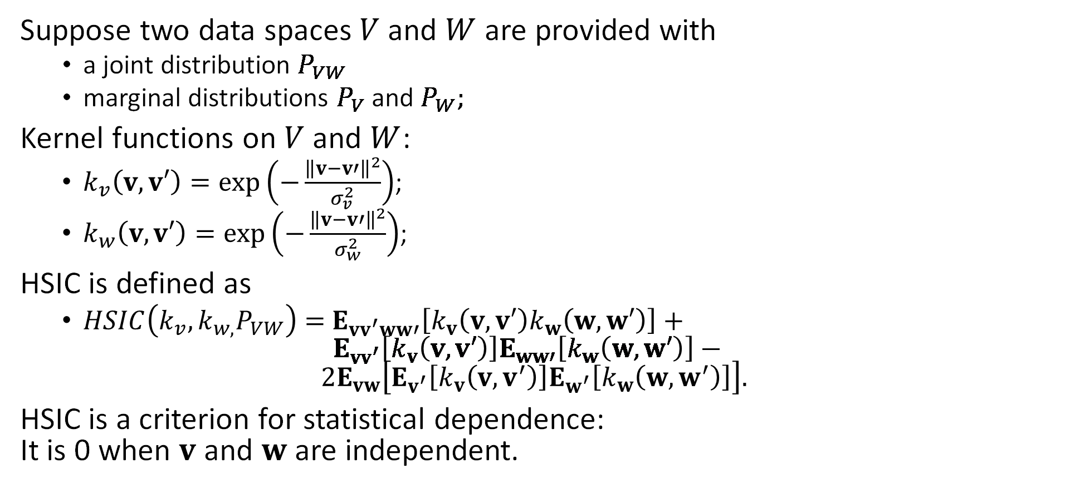
Hilbert-Schmidt independence criterion (HSIC) [GBS05]
Suppose two data spaces $V$ and $W$ are provided with
  a joint distribution $P_{VW}$
  marginal distributions $P_{V}$ and $P_{W};$
Kernel functions on $V$ and $W$:
  $k_{v}\left(v,v′\right)=exp\left(−\frac{{\left\|v−v′\right\|}^{2}}{σ_{v}^{2}}\right)$;
  $k_{w}\left(v,v′\right)=exp\left(−\frac{{\left\|v−v′\right\|}^{2}}{σ_{w}^{2}}\right)$;
HSIC is defined as
  $HSIC\left(k_{v},k_{w,}P_{VW}\right)=$ $E_{vv^{′}ww′}\left[k_{v}\left(v,v′\right)k_{w}\left(w,w′\right)\right]+ E_{vv^{′}}\left[k_{v}\left(v,v′\right)\right]E_{ww′}\left[k_{w}\left(w,w′\right)\right]− 2E_{vw}\left[E_{v^{′}}\left[k_{v}\left(v,v^{′}\right)\right]E_{w^{′}}\left[k_{w}\left(w,w^{′}\right)\right]\right].$
HSIC is a criterion for statistical dependence:
It is 0 when $v$ and $w$ are independent.
Notes:
Our algorithm builds upon two techniques called Hilbert-Schmidt independence criterion (HSIC) and manifold denoising. Here we briefly explain these technique. Suppose that we have two data spaces V and W with the corresponding joint distribution P_VW and marginal distributions P_V and P_W. Now we can define kernel functions on V and W. Then the HSIC is defined based on the expectations of kernel evaluations. It can be shown that when characteristic kernels are used such as Gaussian kernels, HSIC is a proper measure of statistical dependence. For example, HSIC is zero if and only if the corresponding random variables are independent. HSIC offers a good convergence property for finite sample-based evaluations.
Considers expectation of kernel evaluations

Slide 64
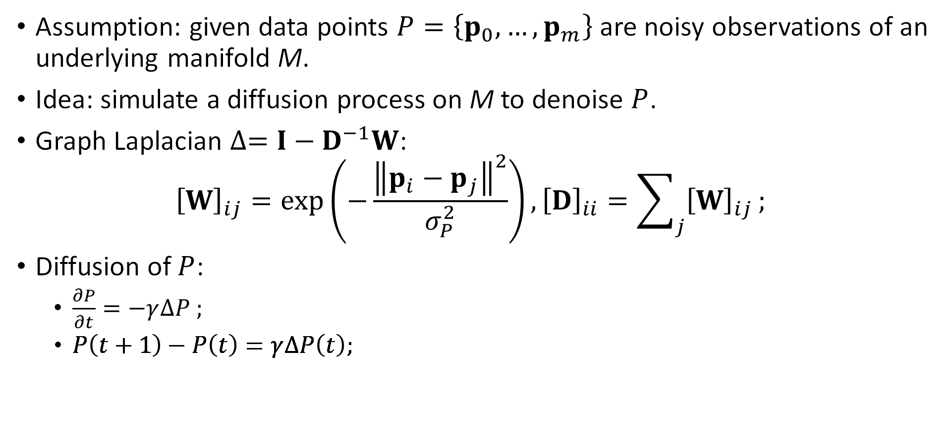
Manifold denoising [HM07]
Assumption: given data points $P=\left\{p_{0},…,p_{m}\right\}$ are noisy observations of an underlying manifold M.
Idea: simulate a diffusion process on M to denoise $P$.
Graph Laplacian $∆=I−D^{−1}W$:
${\left[W\right]}_{ij}=exp\left(−\frac{{\left\|p_{i}−p_{j}\right\|}^{2}}{σ_{P}^{2}}\right),{\left[D\right]}_{ii}=\sum_{j}{{\left[W\right]}_{ij}};$
Diffusion of $P$:
  $\frac{∂P}{∂t}=−γ∆P ;$
  $P\left(t+1\right)−P\left(t\right)=γ∆P\left(t\right);$
Notes:
Manifold denoising is an algorithm that denoises a point cloud that lie in the underlying manifold without having to directly access that manifold. Suppose that we have a set of data points presented as noisy observations of an underlying manifold. Manifold denoising simulates a diffusion process on the manifold denoising P. For this, the generator of diffusion process, the graph Laplacian is constructed based on pairwise similarities W of individual data points.
Using the graph Laplacian, the diffusion is given as a time-evolution equation. The actual denoising algorithm is obtained as a time-discretization obtained based on implicit Euler scheme.

Slide 65
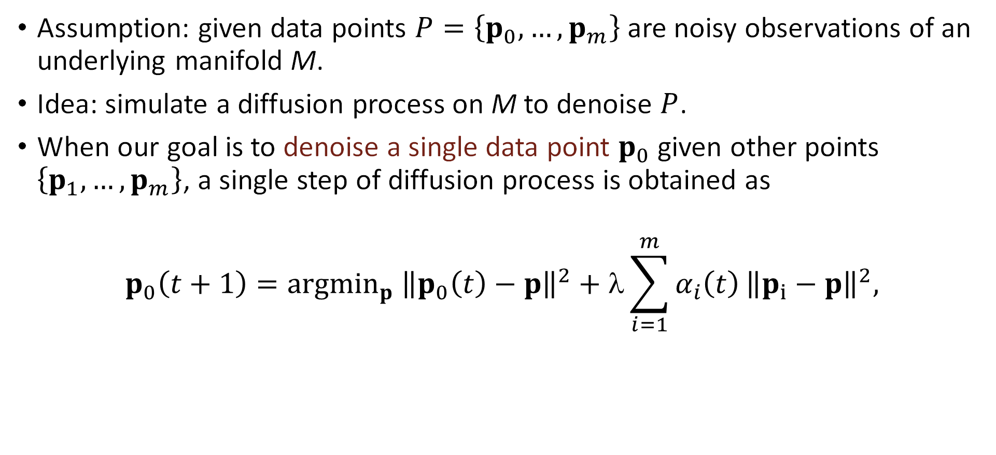
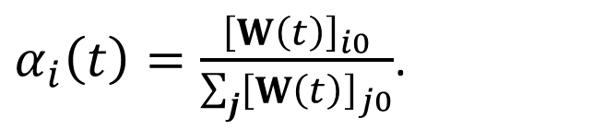
Manifold denoising
Assumption: given data points $P=\left\{p_{0},…,p_{m}\right\}$ are noisy observations of an underlying manifold M.
Idea: simulate a diffusion process on M to denoise $P$.
When our goal is to denoise a single data point $p_{0}$ given other points $\left\{p_{1},…,p_{m}\right\}$, a single step of diffusion process is obtained as
$$p_{0}\left(t+1\right)={argmin}_{p} {\left\|p_{0}\left(t\right)−p\right\|}^{2}+λ\sum_{i=1}^{m}{α_{i}\left(t\right)}{\left\|p_{i}−p\right\|}^{2},$$
$α_{i}\left(t\right)=\frac{{\left[W\left(t\right)\right]}_{i0}}{\sum_{j}{{\left[W\left(t\right)\right]}_{j0}}}$.
Notes:
As shown shortly, we will embed the predictions and extracted features onto a manifold and denoise the predictions. For that, the manifold denoising can be formulated as an evolution of a single data instance given other, fixed points. Specifically, it is given as an iterative algorithm that minimizes an energy below.

Slide 66
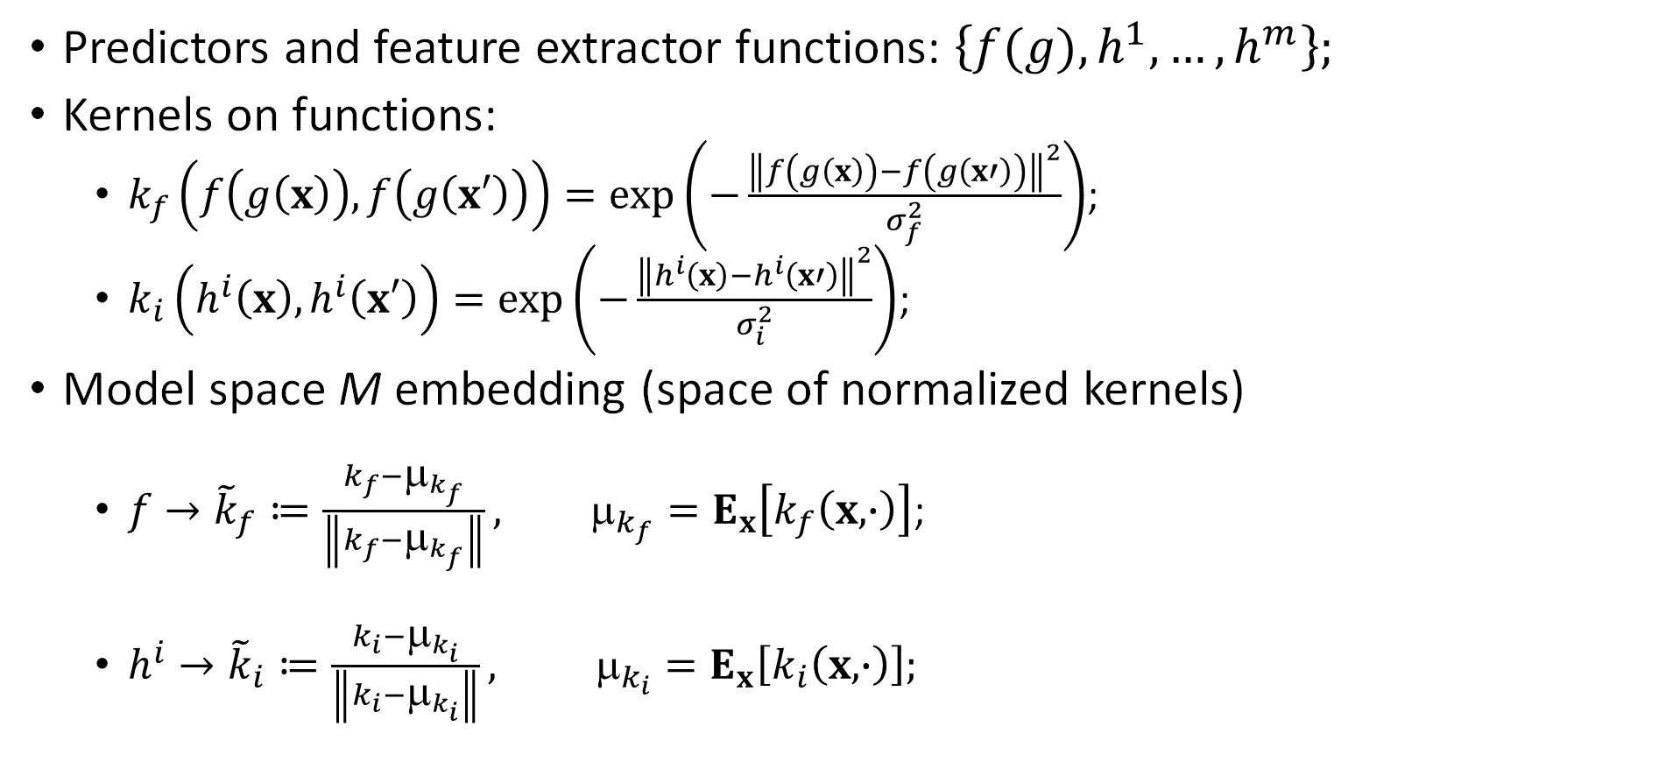
Model space M of predictors and features
Predictors and feature extractor functions: $\left\{f(g), h^{1},…,h^{m}\right\};$
Kernels on functions:
  $k_{f}\left(f\left(g\left(x\right)\right),f\left(g\left(x′\right)\right)\right)=exp\left(−\frac{{\left\|f\left(g\left(x\right)\right)−f\left(g\left(x′\right)\right)\right\|}^{2}}{σ_{f}^{2}}\right)$;
  $k_{i}\left(h^{i}\left(x\right),h^{i}\left(x′\right)\right)=exp\left(−\frac{{\left\|h^{i}\left(x\right)−h^{i}\left(x′\right)\right\|}^{2}}{σ_{i}^{2}}\right)$;
Model space M embedding (space of normalized kernels)
  $f→{\tilde{k}}_{f}≔\frac{k_{f}−μ_{k_{f}}}{\left\|k_{f}−μ_{k_{f}}\right\|}, μ_{k_{f}}=E_{x}\left[k_{f}\left(x,∙\right)\right]$;
  $h^{i}→{\tilde{k}}_{i}≔\frac{k_{i}−μ_{k_{i}}}{\left\|k_{i}−μ_{k_{i}}\right\|}, μ_{k_{i}}=E_{x}\left[k_{i}\left(x,∙\right)\right];$
Notes:
Now we are ready to define our model manifold. Suppose that we have initial predictor function and feature extraction functions. Here we combine the original feature extractor g and predictor f. In this case, all predictions and feature extractors are defined on the original input data space and therefore, we can define the corresponding kernels on the input space.
Now our model manifold is obtained by casting the predictor function and feature extractor functions to the corresponding kernel functions.

Slide 67
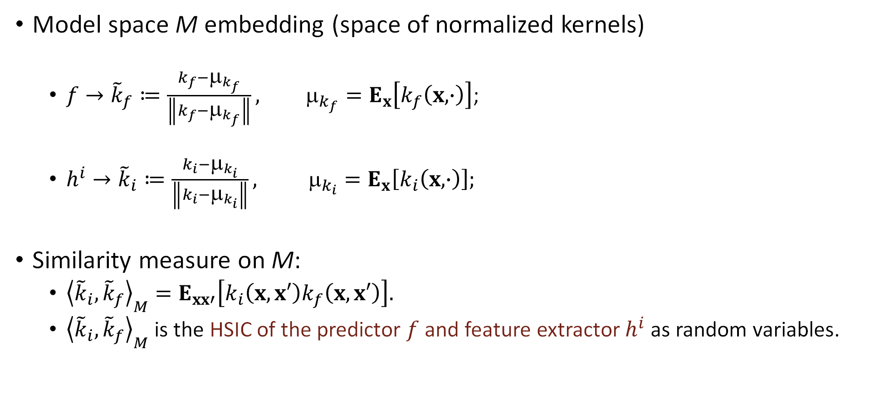
Model space M of predictors and features
Model space M embedding (space of normalized kernels)
  $f→{\tilde{k}}_{f}≔\frac{k_{f}−μ_{k_{f}}}{\left\|k_{f}−μ_{k_{f}}\right\|}, μ_{k_{f}}=E_{x}\left[k_{f}\left(x,∙\right)\right]$;
  $h^{i}→{\tilde{k}}_{i}≔\frac{k_{i}−μ_{k_{i}}}{\left\|k_{i}−μ_{k_{i}}\right\|}, μ_{k_{i}}=E_{x}\left[k_{i}\left(x,∙\right)\right];$
Similarity measure on M:
  ${\left\langle {\tilde{k}}_{i},{\tilde{k}}_{f}\right\rangle }_{M}=E_{xx′}\left[k_{i}\left(x,x′\right)k_{f}\left(x,x′\right)\right].$
  ${\left\langle {\tilde{k}}_{i},{\tilde{k}}_{f}\right\rangle }_{M}$ is the HSIC of the predictor $f$ and feature extractor $h^{i}$ as random variables.
Notes:
In this case, the natural similarity measure on the manifold is given in the form of the inner-product between kernels. This is precisely the HSIC between the respective functions when we consider them as random variables. To summarize, our manifold embed the predictor and feature extractors in the way that their similarity can be measured based on the corresponding statistical dependence.

Slide 68
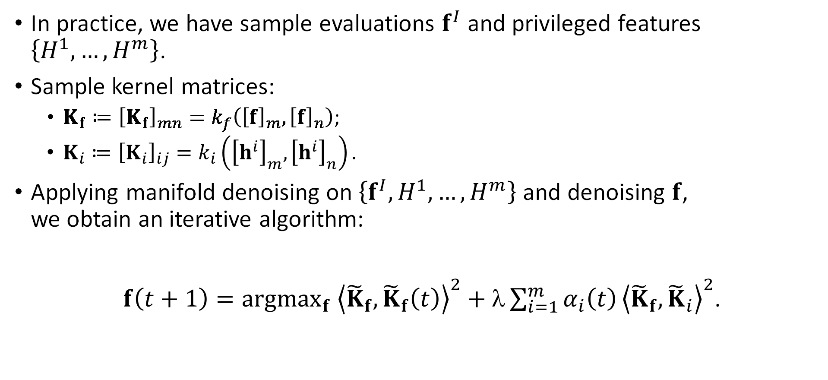
TUPI algorithm
In practice, we have sample evaluations $f^{I}$ and privileged features $\left\{H^{1},…,H^{m}\right\}$.
Sample kernel matrices:
  $K_{f}≔{\left[K_{f}\right]}_{mn}=k_{f}\left({\left[f\right]}_{m},{\left[f\right]}_{n}\right)$;
  $K_{i}≔{\left[K_{i}\right]}_{ij}=k_{i}\left({\left[h^{i}\right]}_{m},{\left[h^{i}\right]}_{n}\right).$
Applying manifold denoising on $\left\{f^{I},H^{1},…,H^{m}\right\}$ and denoising $f$,
we obtain an iterative algorithm:
$f\left(t+1\right)={argmax}_{f} {\left\langle {\tilde{K}}_{f},{\tilde{K}}_{f}\left(t\right)\right\rangle }^{2}+λ\sum_{i=1}^{m}{α_{i}\left(t\right)}{\left\langle {\tilde{K}}_{f},{\tilde{K}}_{i}\right\rangle }^{2}$.
Notes:
%In practice, we won’t be able to integrate the predictor and feature extractor functions directly. Instead, we improve the sample evaluations. The corresponding kernel matrices are given as K_f and K_i.
Now we can apply manifold denoising to our predictor and feature manifold given as an iterative update rule of the sample evaluation f:
Our algorithm iteratively enforces the similarity with respect to the kernel matrices constructed from the predictors and privileged features.

Slide 69

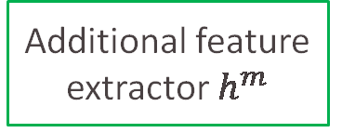



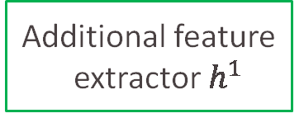

Testing Using Privileged Information
By Adapting Features with Statistical Dependence
Training
: Feature extractor $g$ and predictor $f$
Kwang In Kim
Testing
$$X=\left\{x_{1},…,x_{n}\right\}$$
Feature
extractor $g$
Additional feature
extractor $h^{1}$
Additional feature
extractor $h^{m}$
$$⋯$$
$$G=\left\{g_{1},…,g_{n}\right\}$$
$$H^{1}=\left\{h_{1}^{1},…,h_{1}^{1}\right\}$$
$$H^{m}=\left\{h_{1}^{m},…,h_{1}^{m}\right\}$$
James Tompkin
Initial
predictor $f$
Optimized predictor
Statistical dependence
feature adaptation
$$f^{I}=\left\{f\left(g_{1}\right),…,f\left(g_{n}\right)\right\}$$
$$f^{O}=\left\{f_{1}^{O},…,f_{n}^{O}\right\}$$

